Slide 1
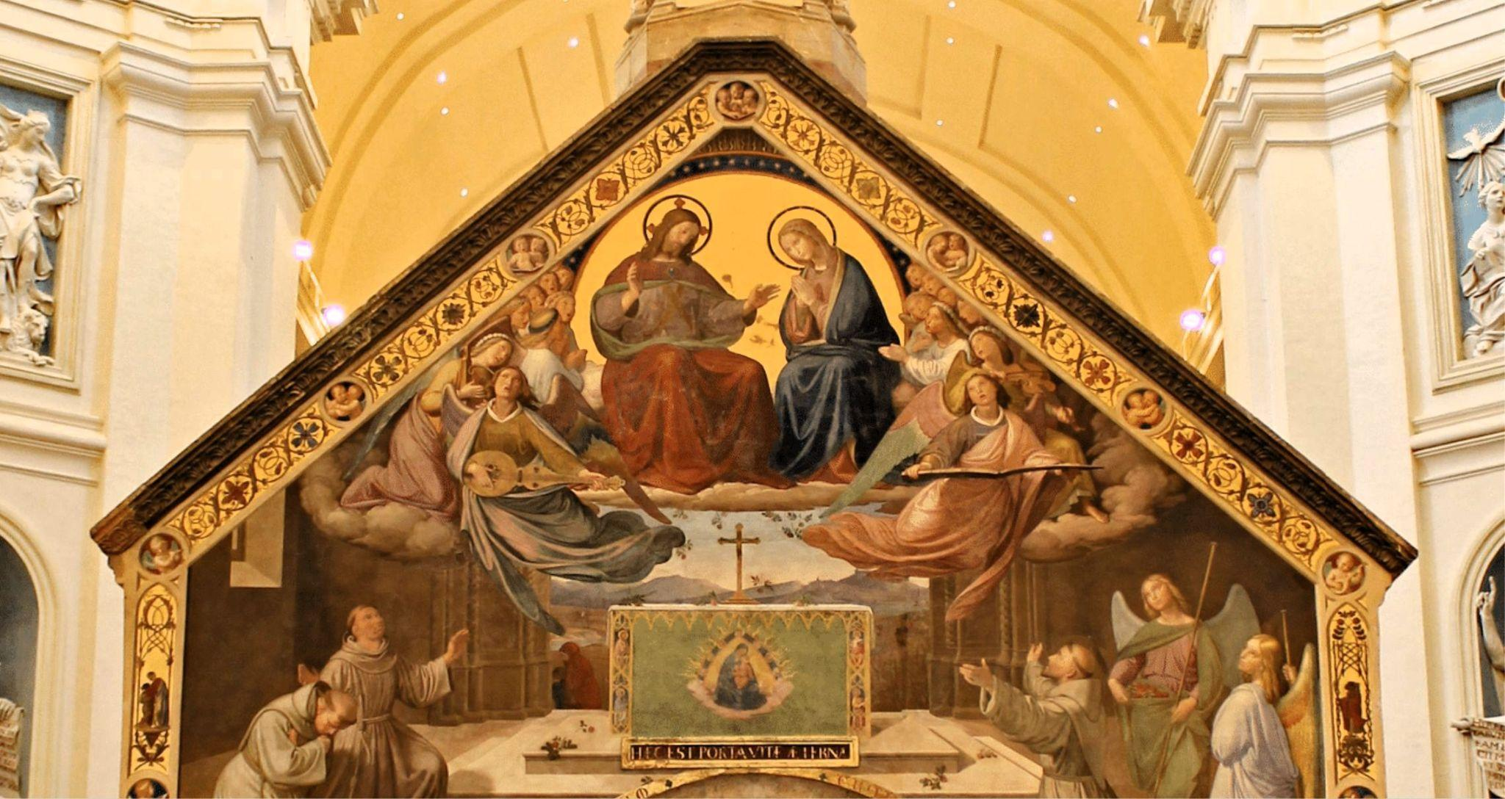
Novena to
Our lady of the angels

Slide 2
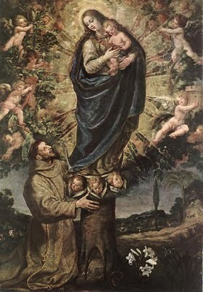
Novena & Rosary to
Our Lady of The Angels
July 24 - August 1
2026
Special Intention: peace in the world
Vision of St. Francis of Assisi
by Vincente Carducho – 1631

Slide 3
Friday July 24 & 31, 2026
&
Tuesday July 28, 2026

Slide 4
Novena Prayer to Our Lady of The Angels
O Virgin of the Angels,
who has for centuries established your throne of mercy at the Portiuncula,
hear the prayer of your children, who trust in you.
From this truly holy place and the habitation of the Lord,
so dear to the heart of Saint Francis, you have always invited all men to love.
Your tender eyes assure us of a never-failing motherly help
and a promise of divine help to all those who humbly have recourse to your throne,
or who from afar, turn to you to ask for help.
You are, indeed, our sweet Queen and our only hope.
O Lady of the Angels,
obtain for us, through the intercession of blessed Francis,
pardon for our sins,
help us to keep away from sin and indifference,
so that we shall be worthy of calling you our Mother for evermore.
Bless our homes, our toil and our rest,
by giving us that same serenity we experience within the walls of the Portiuncula,
where hate, guilt and tears turn into a song of joy
like that once was sung by the Angels and the seraphic Francis.
Help those who are in need and hungry,
those who are in danger of body and soul,
those who are sad and downhearted,
those who are sick and dying.
Bless us, your most beloved children,
and we pray you, bless also with the same motherly gesture,
all those who are innocent, together with those who are guilty;
those who are faithful, together with those who have gone astray;
those who believe, together with those who are in doubt.
Bless all humanity,
so that all men acknowledging that they are God’s children,
would find through love, real Peace and real Good.
Amen

Slide 5
Vergin Tutto Amor by Friar Alessandro
Vergin tutto amor
O madre di bontade
O madre pia, madre pia
Ascolta, dolce Maria
La voce del peccator
Del peccator
Il pianto suo ti muova
Giunga a notte i suoi lamenti
Suo qual suoi tristi accenti
Senti pietoso quel tuo cor
Pietoso, pietoso
Pietoso quel tuo cor
Quel tuo cor
O madre di bontade
Vergin tutto amor
O madre di bontade
O vergin tutto amore
Vergin tutto amor
Amor
O Virgin full of love
O Mother of goodness
O pious Mother, O pious Mother
Hear, sweet Mary
the voice of the sinner
of the sinner
May his weeping move you
May his lamentations reach you in the night
with their sorrowful tones
May your heart hear them with compassion Compassionate, compassionate,
May your heart be compassionate,
That heart of yours,
O Mother of kindness
O Virgin, all love
O Mother of kindness
O Virgin, all love
O Virgin, all love,
Love

Slide 6
Sorrowful Mysteries
In the name of the Father and the son and of the Holy Spirit.
Apostles Creed:
I believe in God, the Father Almighty, creator of heaven and earth and in Jesus Christ his only begotten Son, our Lord, who was conceived by the Holy Spirit, born of the Virgin Mary, suffered under Pontius Pilate, was crucified died and was buried. He descended into hell, on the third day he rose again from the dead, he ascended into heaven, and is seated at the right hand of God, the Father Almighty, from there he will come to judge the living and the dead.
- I believe in the Holy Spirit, the Holy Catholic Church, the communion of saints, the forgiveness of sins, the resurrection of the body and life everlasting. Amen.

Slide 7
Our Father:
Our Father, who art in heaven, hallowed be thy name. Thy kingdom come. Thy will be done on earth as it is in heaven.
- Give us this day our daily bread and forgive us our trespasses as we forgive those who trespass against us. And lead us not into temptation but deliver us from evil. Amen.
For an increase in Faith, Hope and Charity, let us pray:
Hail Mary X3:
Hail Mary, full of grace the Lord is with thee. Blessed art thou amongst women and blessed is the fruit of thy womb, Jesus.
- Holy Mary, Mother of God, pray for us sinners, now And at the hour of our death. Amen
Glory Be:
Glory be to the Father and to the Son and to the Holy Spirit. As it was in the beginning, is now and ever shall be, world without end. Amen

Slide 8
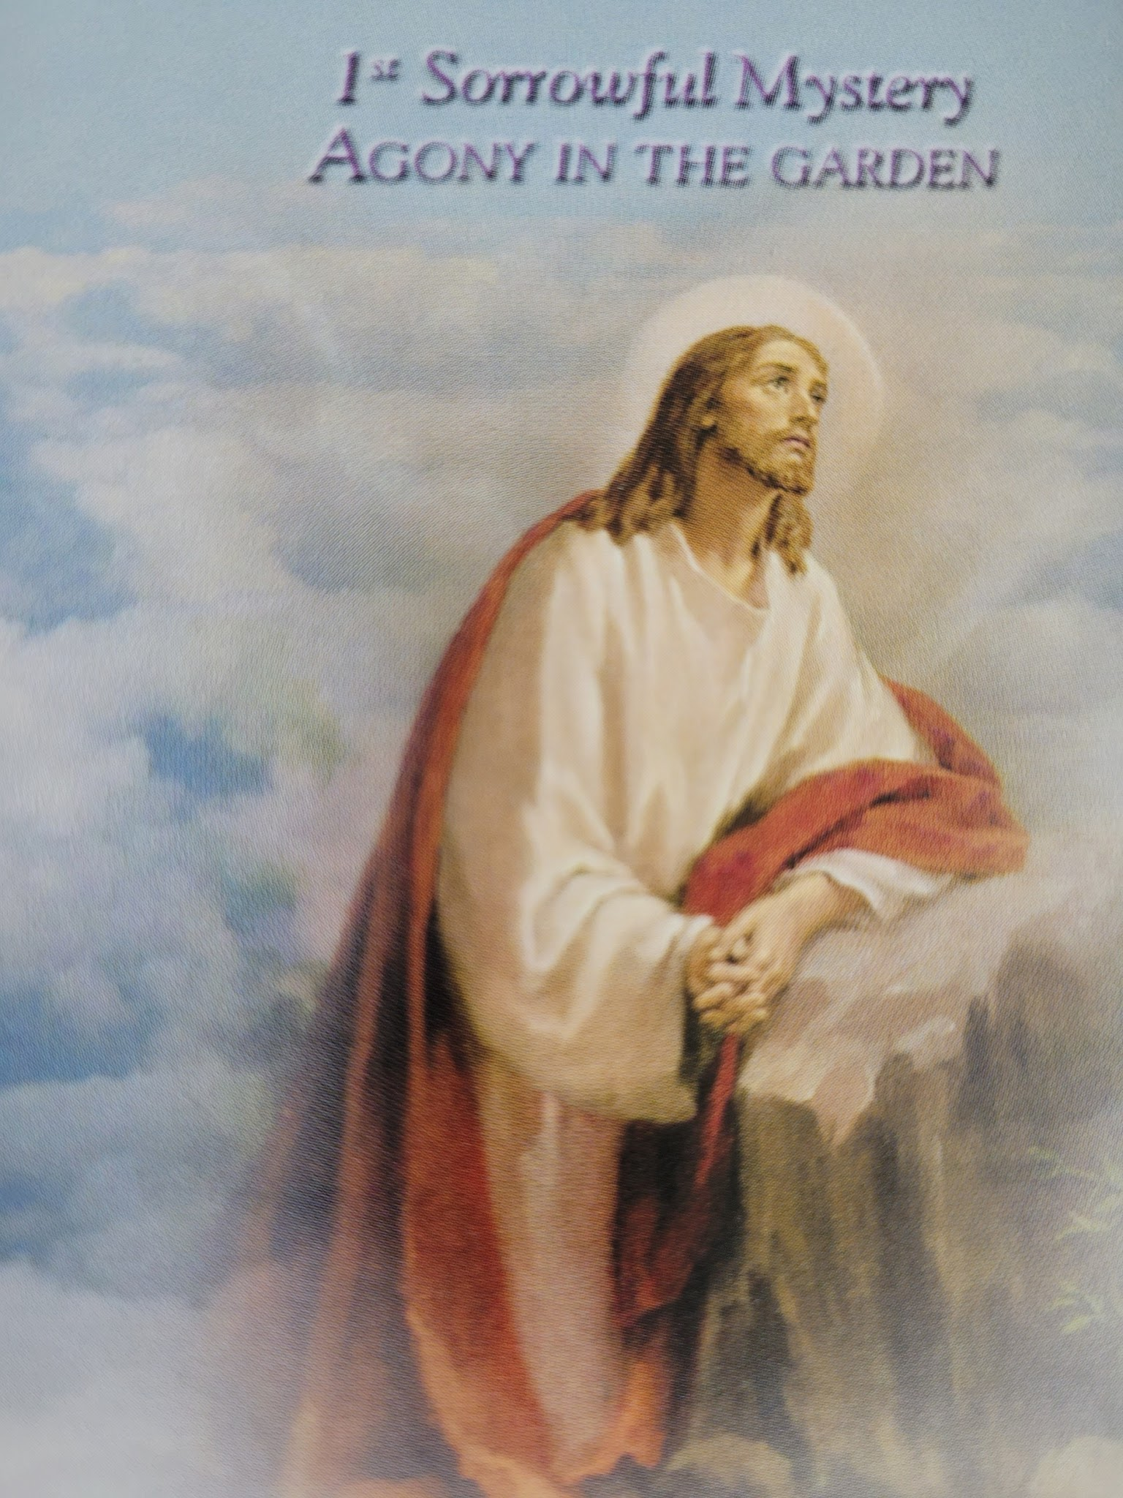
And being in agony, He was praying very fervently; and his sweat became like drops of blood, falling down upon the ground.
(Luke 22: 44)
Our Father…
Hail Mary…. X10
Glory Be.
Oh, my Jesus forgive us our sins, save us from the fires of hell. Lead all souls to heaven, especially those who are most in need of your mercy. Amen

Slide 9
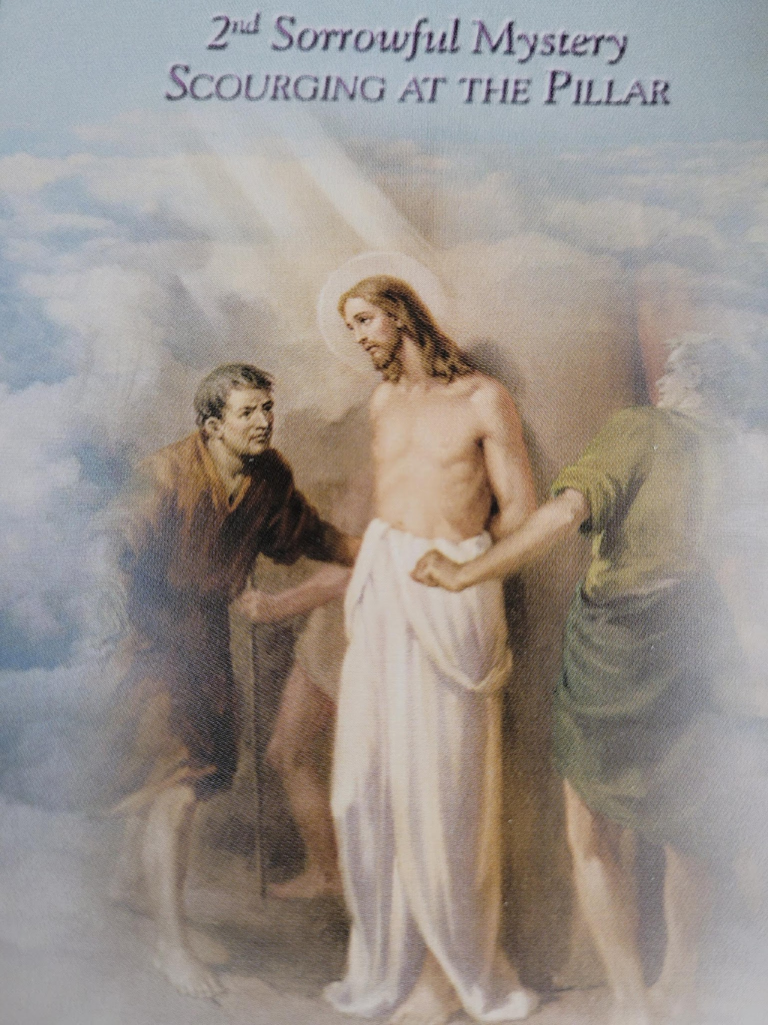
Wishing to satisfy the crowd, Pilate released Barabbas for them, and after having Jesus scourged, he handed him over to be crucified.
(Mark 15:15)
Our Father….
Hail Mary…. X10
Glory Be….
Oh, my Jesus forgive us our sins, save us from the fires of hell. Lead all souls to heaven, especially those who are most in need of your mercy. Amen

Slide 10
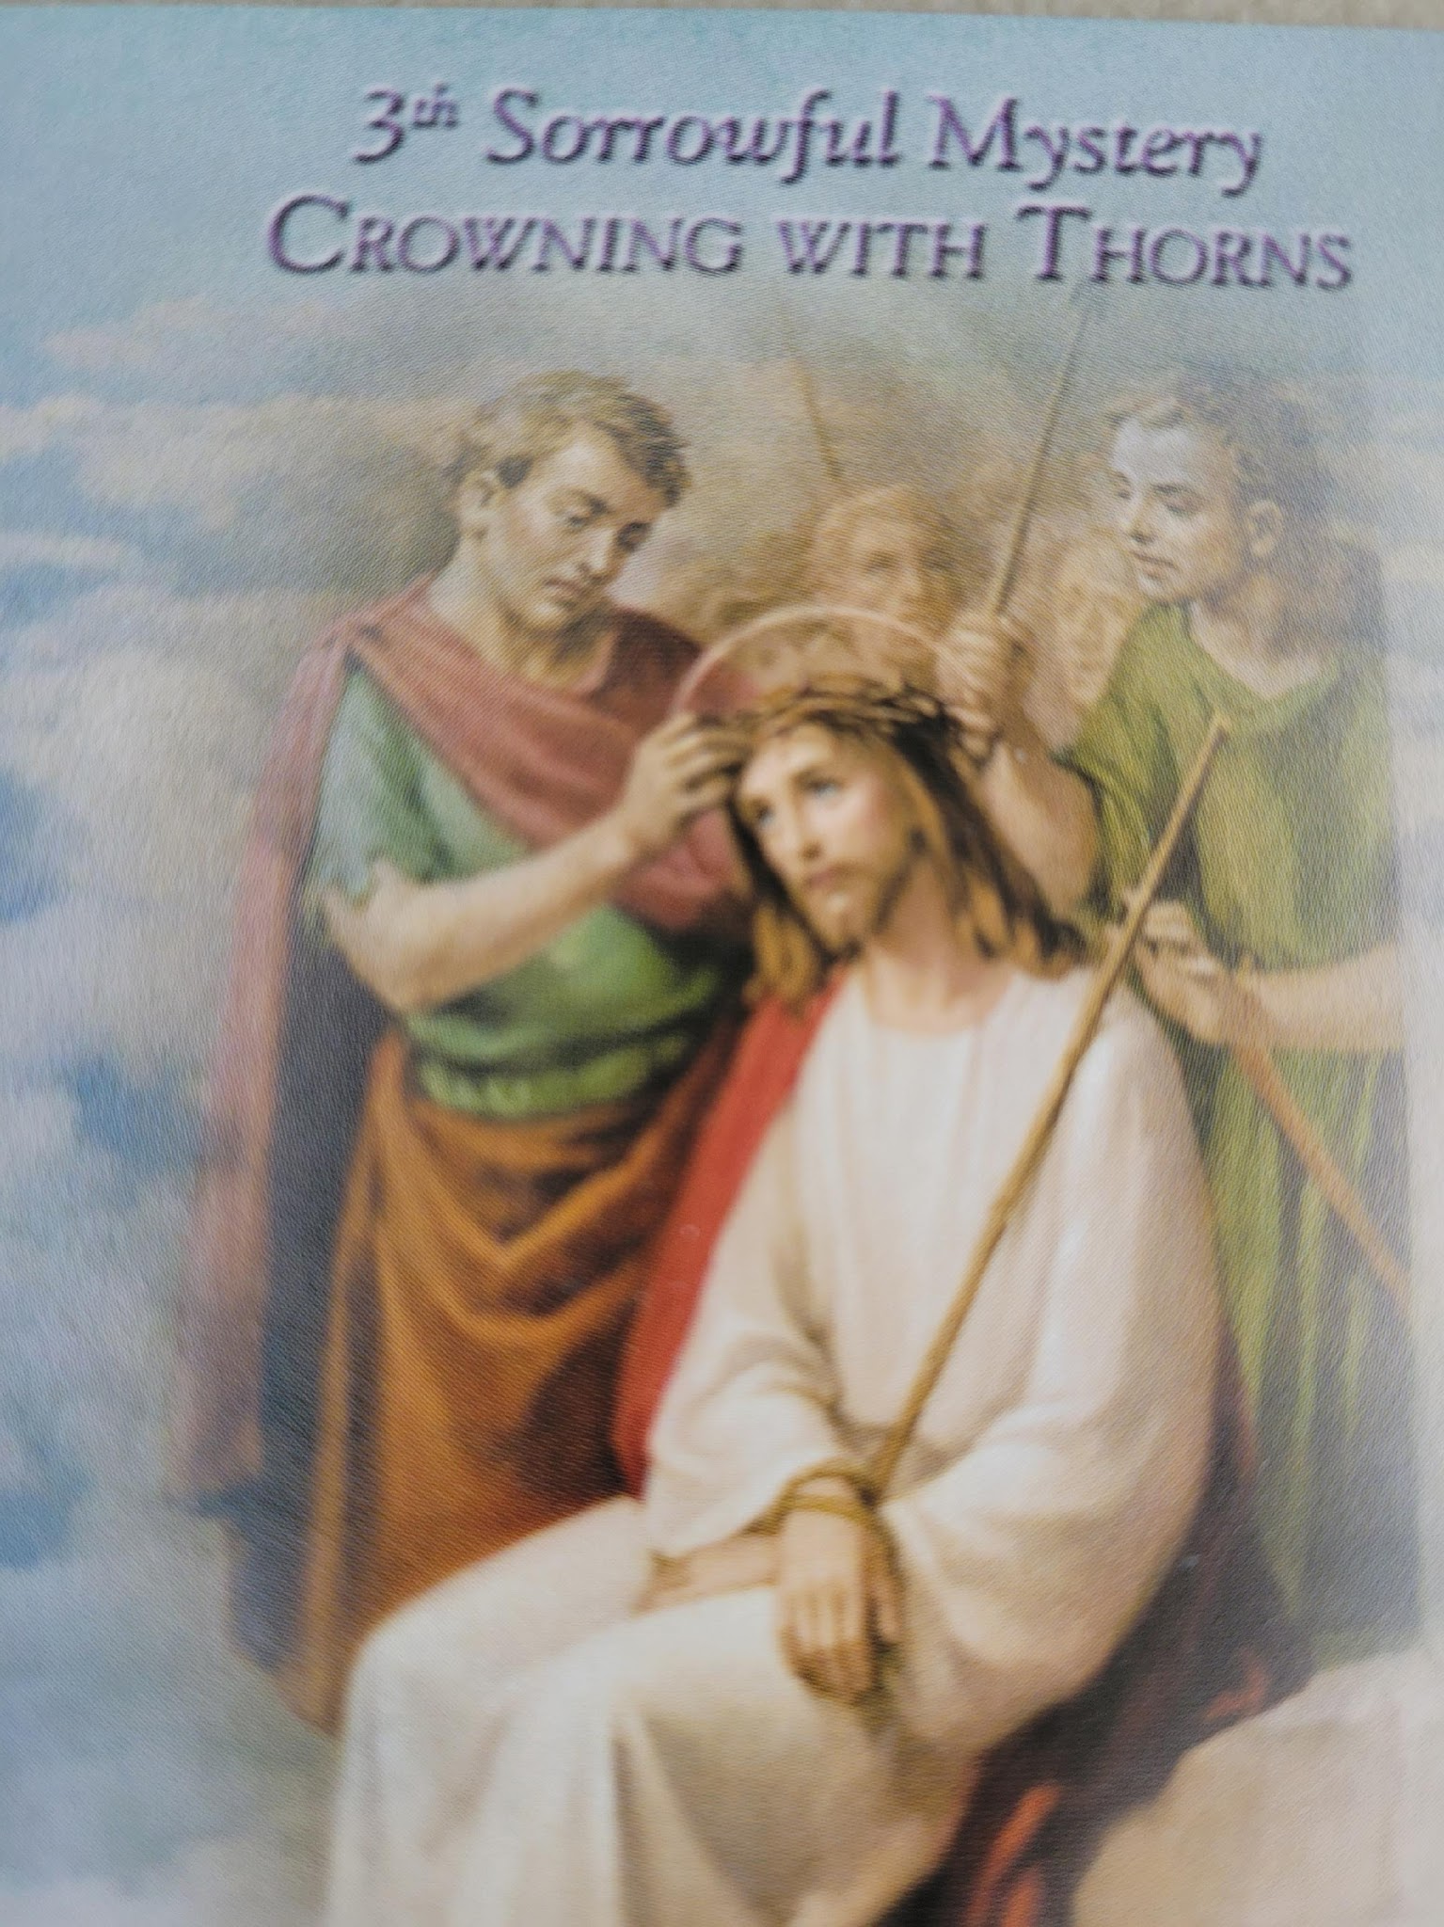
And after twisting together a crown of thorns, they put it on His head, and a reed in His right hand; and they knelt down before him and mocked him, saying, “Hail, King of the Jews!” They spat on him and took the reed and began to beat him on the head.
(Matt. 27: 29-30)
Our Father….
Hail Mary…. X10
Glory Be….
Oh, my Jesus forgive us our sins, save us from the fires of hell. Lead all souls to heaven, especially those who are most in need of your mercy. Amen

Slide 11
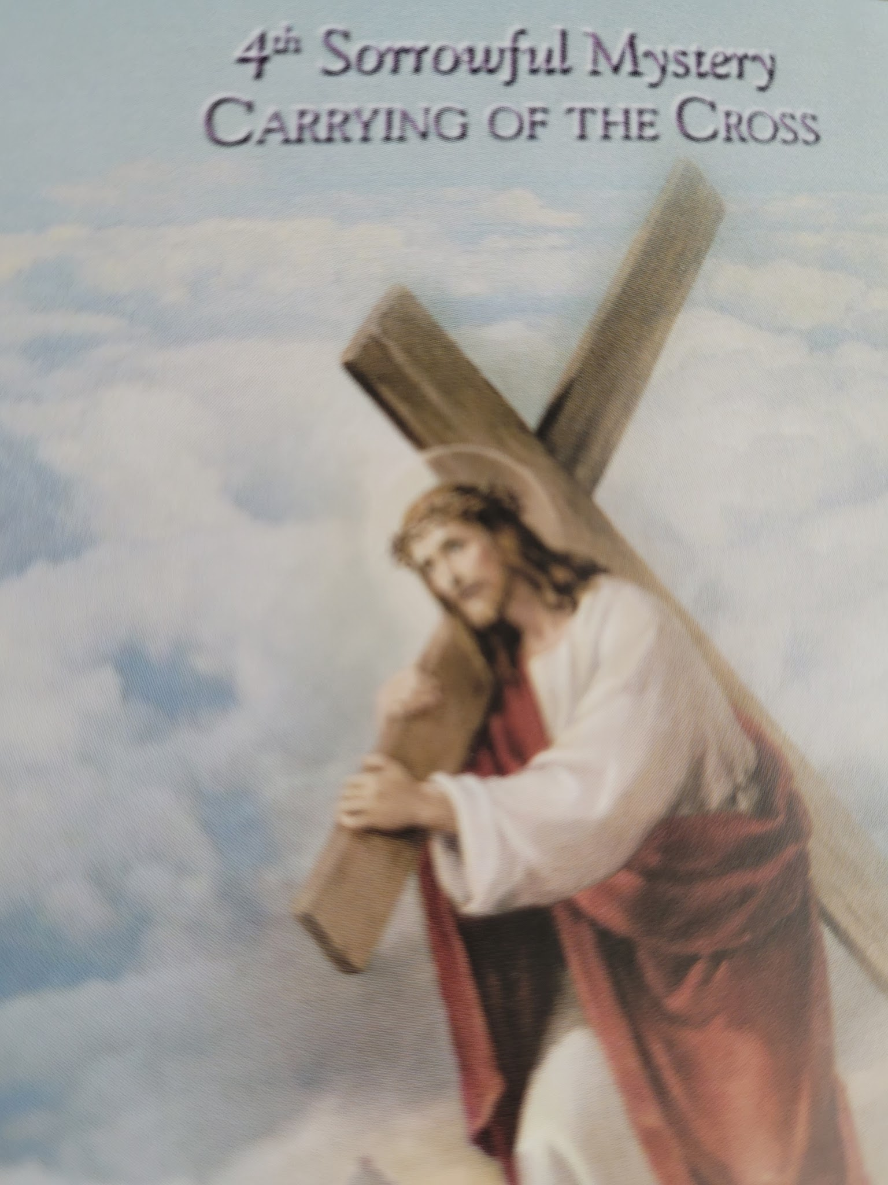
So, he then handed Him over to them to be crucified. They took Jesus, therefore, and He went out, bearing His own cross, to the place called the Place of a Skull, which is called in Hebrew, Golgotha.
(John 19: 16-17)
Our Father….
Hail Mary…. X10
Glory Be….
Oh, my Jesus forgive us our sins, save us from the fires of hell. Lead all souls to heaven, especially those who are most in need of your mercy. Amen

Slide 12
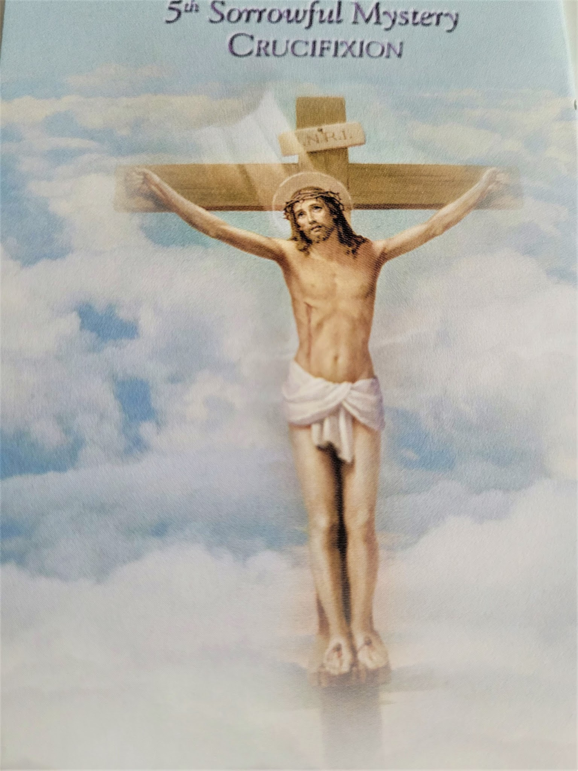
Therefore, when Jesus had received the sour wine, He said, “It is finished!” And he bowed his head and gave up His spirit.
(John 19:30)
Our Father….
Hail Mary…. X10
Glory Be….
Oh, my Jesus forgive us our sins, save us from the fires of hell. Lead all souls to heaven, especially those who are most in need of your mercy. Amen

Slide 13
Hail Holy Queen:
Hail Holy Queen, Mother of Mercy! Our life, our sweetness and our hope! To thee do we cry, poor banished children of Eve, to thee do we send up our sighs, mourning and weeping in this valley of tears. Turn then, most gracious advocate, thy eyes of mercy towards us; and after this, our exile, show unto us the blessed fruit of thy womb, Jesus. O clement, O loving, O sweet Virgin Mary. Pray for us O Holy Mother of God, That we may be made worthy of the promises of Christ.

Slide 14
Lord have mercy
- Lord have mercy
Christ have mercy
- Christ have mercy
Lord have mercy
- Lord have mercy
Christ hear us.
- Christ graciously hear us.
God the Father of heaven
- Have mercy on us
God the Son, Redeemer of the world
-Have mercy on us.
God the Holy Spirit
- Have mercy on us.
Holy Trinity, one God
- Have mercy on us.
Holy Mary
- Pray for us
Mother of God
-Pray for us
Saint Joseph
- Pray for us
Saint Anne
- Pray for us
Saint Francis
- Pray for us
Saint Claire
- Pray for us.
Saint Ferdinand III of Castille
- Pray for us
Saint Zita of Lucca
- Pray for us
Saint Anna Schaeffer
- Pray for us
Saint Rose of Vitebro
- Pray for us
Saint Thomas Moore
- Pray for us

Slide 15
Grant, we beseech Thee, O Lord God, unto us thy servants, that we may rejoice in continual health of mind and body, and by the glorious intercession of the Blessed Mary, ever Virgin, may be delivered from present sadness, and enter into the joy of thine eternal gladness. Through Christ our Lord. Amen

Slide 16
Grant, we beseech Thee, O Lord God, unto us thy servants, that we may rejoice in continual health of mind and body, and by the glorious intercession of the Blessed Mary, ever Virgin, may be delivered from present sadness, and enter into the joy of thine eternal gladness. Through Christ our Lord. Amen

Slide 17
Novena & Rosary to
Our Lady of The Angels
July 24 - August 1
2026
Special Intention: peace in the world
Vision of St. Francis of Assisi”
by Vincente Carducho – 1631

Slide 18
Sunday July 26, 2026
&
Wednesday July 29, 2026

Slide 19
Novena Prayer to Our Lady of The Angels
O Virgin of the Angels,
who has for centuries established your throne of mercy at the Portiuncula,
hear the prayer of your children, who trust in you.
From this truly holy place and the habitation of the Lord,
so dear to the heart of Saint Francis, you have always invited all men to love.
Your tender eyes assure us of a never-failing motherly help
and a promise of divine help to all those who humbly have recourse to your throne,
or who from afar, turn to you to ask for help.
You are, indeed, our sweet Queen and our only hope.
O Lady of the Angels,
obtain for us, through the intercession of blessed Francis,
pardon for our sins,
help us to keep away from sin and indifference,
so that we shall be worthy of calling you our Mother for evermore.
Bless our homes, our toil and our rest,
by giving us that same serenity we experience within the walls of the Portiuncula,
where hate, guilt and tears turn into a song of joy
like that once was sung by the Angels and the seraphic Francis.
Help those who are in need and hungry,
those who are in danger of body and soul,
those who are sad and downhearted,
those who are sick and dying.
Bless us, your most beloved children,
and we pray you, bless also with the same motherly gesture,
all those who are innocent, together with those who are guilty;
those who are faithful, together with those who have gone astray;
those who believe, together with those who are in doubt.
Bless all humanity,
so that all men acknowledging that they are God’s children,
would find through love, real Peace and real Good.
Amen

Slide 20
Mary’s Song
My soul doth glory in your love, O Lord.
My soul doth glory in your love, O Lord,
For you gazed on your servant with compassion;
And you reached out and took me by the hand.
Great are you God, and Holy is your name.
Your mercy reaches to the end of time;
Ah the lowly you raise to the heavens,
And the proud-hearted have no part with you.
Ah, how you fill the hungry with your love.
With empty hands, the rich are sent away.
You will always be mindful of your mercy,
As you promised your people, long ago.
My soul doth glory in your love, O Lord.
My soul doth glory in your love, O Lord.
For you smiled on your servant with compassion,
And you reached out and took me by the hand.
Sung by Chris Brunelle

Slide 21
Glorious Mysteries
In the name of the Father and the son and of the Holy Spirit.
Apostles Creed:
I believe in God, the Father Almighty, creator of heaven and earth and in Jesus Christ his only begotten Son, our Lord, who was conceived by the Holy Spirit, born of the Virgin Mary, suffered under Pontius Pilate, was crucified died and was buried. He descended into hell, on the third day he rose again from the dead, he ascended into heaven, and is seated at the right hand of God, the Father Almighty, from there he will come to judge the living and the dead.
- I believe in the Holy Spirit, the Holy Catholic Church, the communion of saints, the forgiveness of sins, the resurrection of the body and life everlasting. Amen.

Slide 22
Our Father:
Our Father, who art in heaven, hallowed be thy name. Thy kingdom come. Thy will be done on earth as it is in heaven.
- Give us this day our daily bread and forgive us our trespasses as we forgive those who trespass against us. And lead us not into temptation but deliver us from evil. Amen.
For an increase in Faith, Hope and Charity, let us pray:
Hail Mary X3:
Hail Mary, full of grace the Lord is with thee. Blessed art thou amongst women and blessed is the fruit of thy womb, Jesus.
- Holy Mary, Mother of God, pray for us sinners, now and at the hour of our death. Amen
Glory Be:
Glory be to the Father and to the Son and to the Holy Spirit. As it was in the beginning, is now and ever shall be, world without end. Amen

Slide 23
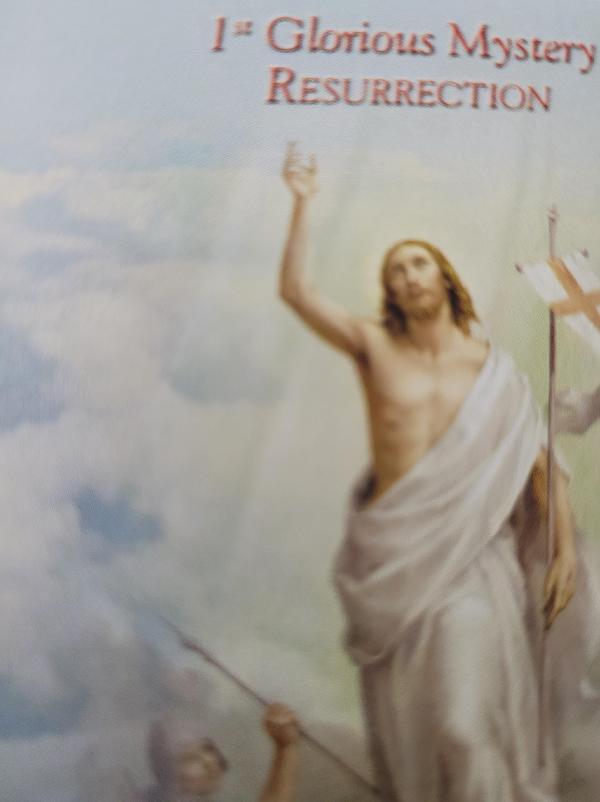
The angel said to the women, “Do not be afraid; for I know that you are looking for Jesus who has been crucified. He is not here, for He has risen, just as He said.”
(Matt 28: 5-6)
Our Father…
Hail Mary…. X10
Glory Be.
Oh, my Jesus forgive us our sins, save us from the fires of hell. Lead all souls to heaven, especially those who are most in need of your mercy. Amen

Slide 24
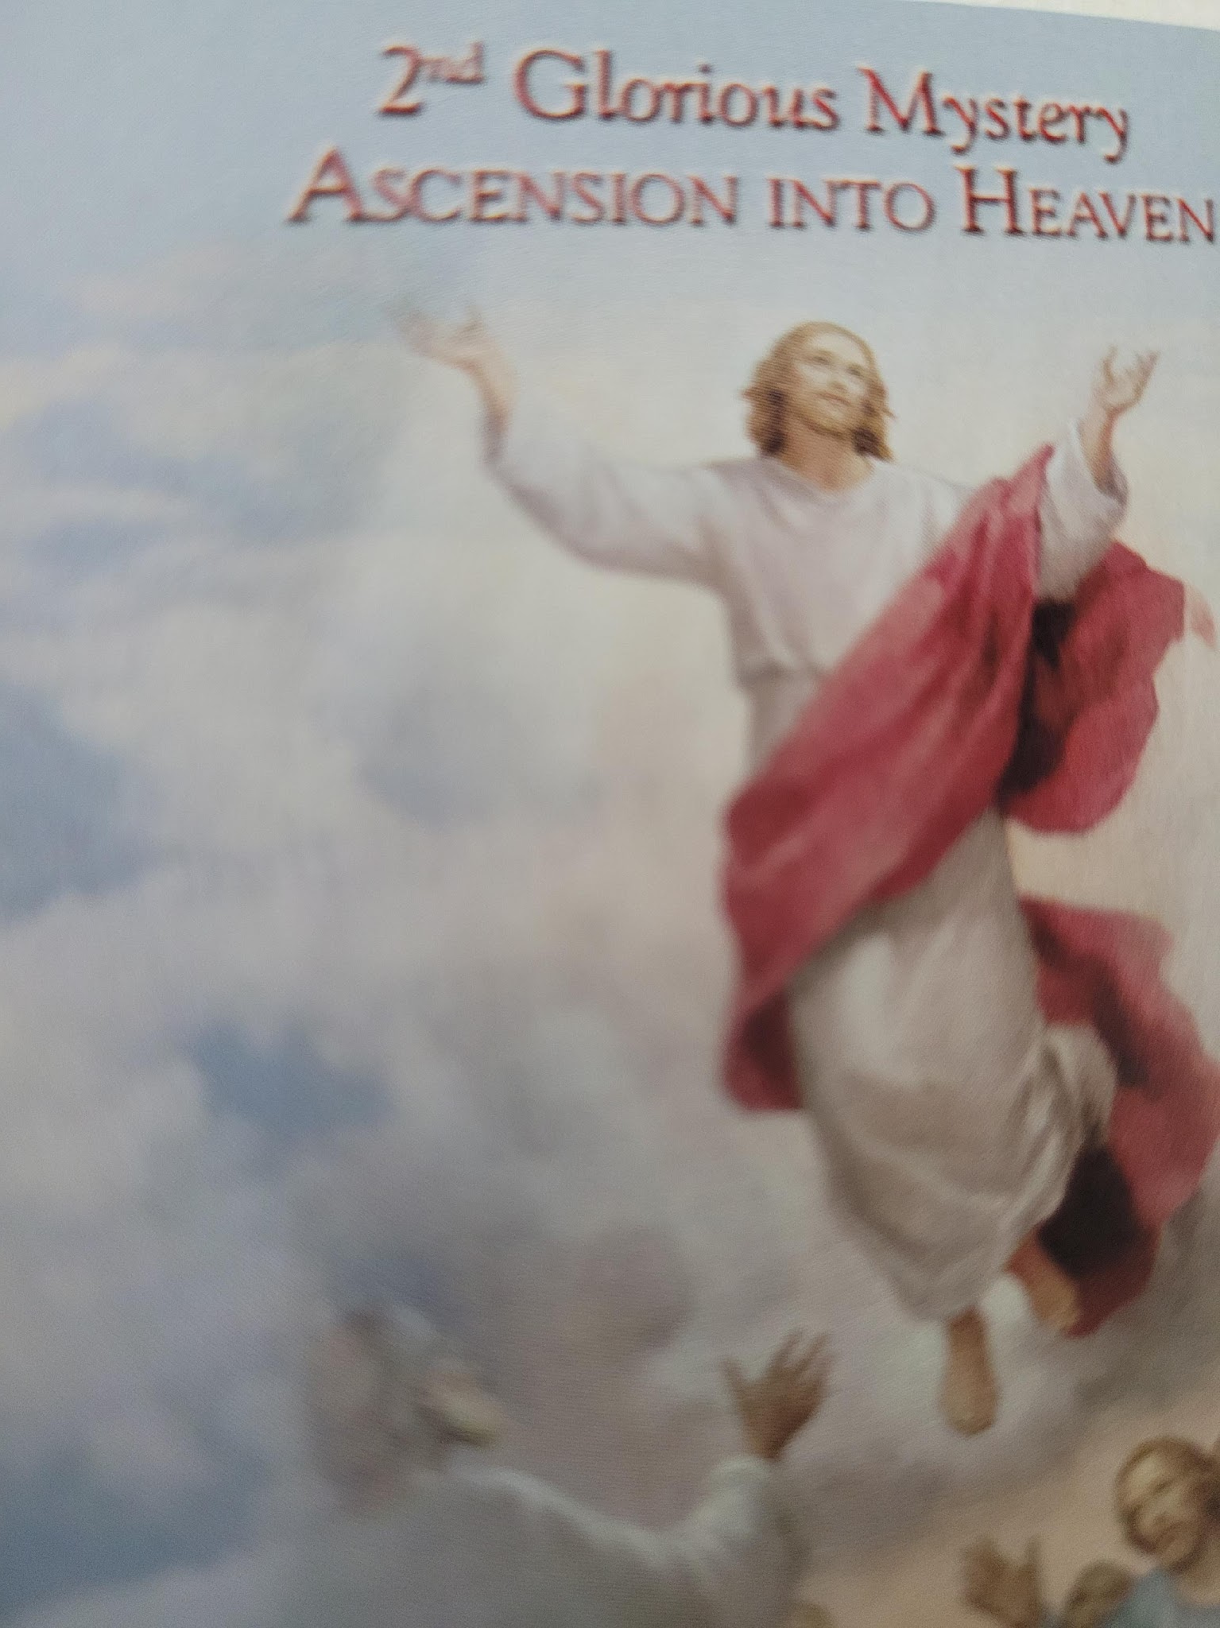
So then, when the Lord Jesus had spoken to them, He was received up into heaven and sat down at the right hand of God.
(Mark 16:19)
Our Father….
Hail Mary…. X10
Glory Be….
Oh, my Jesus forgive us our sins, save us from the fires of hell. Lead all souls to heaven, especially those who are most in need of your mercy. Amen

Slide 25
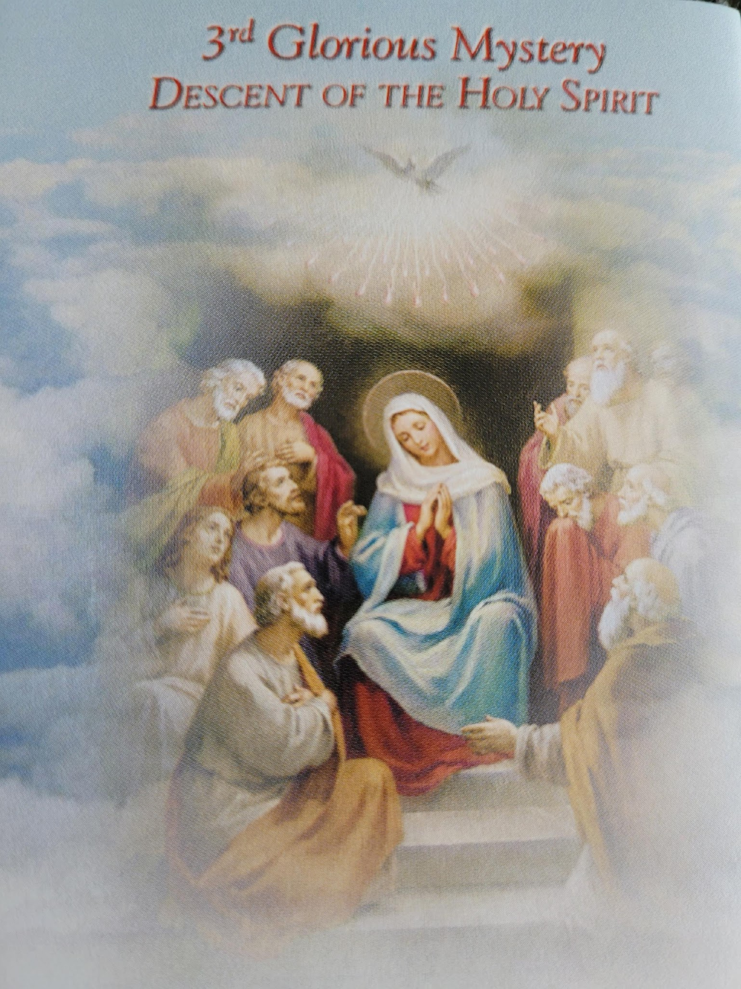
And there appeared to them tongues of fire distributing themselves, and they rested on each one of them. And they were filled with the Holy Spirit and began to speak with other tongues, as the Spirit was giving them utterance.
(Acts 2: 3-4)
Our Father….
Hail Mary…. X10
Glory Be….
Oh, my Jesus forgive us our sins, save us from the fires of hell. Lead all souls to heaven, especially those who are most in need of your mercy. Amen

Slide 26
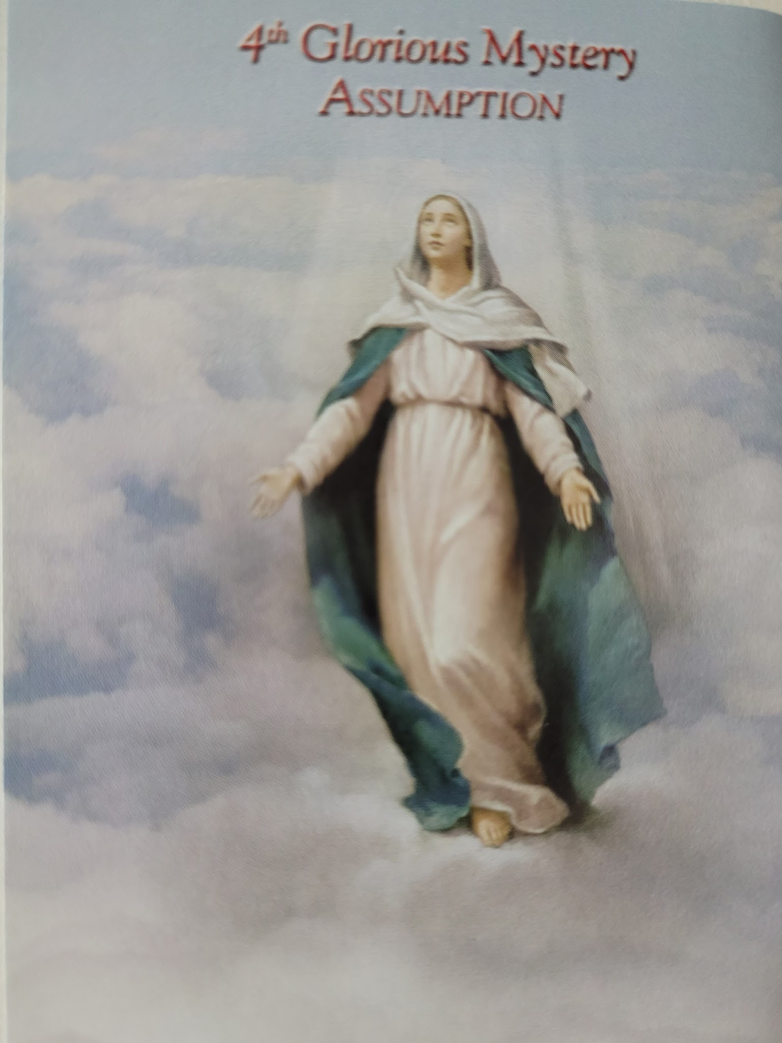
For behold, from this time on all generations will call me blessed. For the Mighty One has done great things for me and Holy is His name.
(Luke 1: 48-49)
Our Father….
Hail Mary…. X10
Glory Be….
Oh, my Jesus forgive us our sins, save us from the fires of hell. Lead all souls to heaven, especially those who are most in need of your mercy. Amen

Slide 27
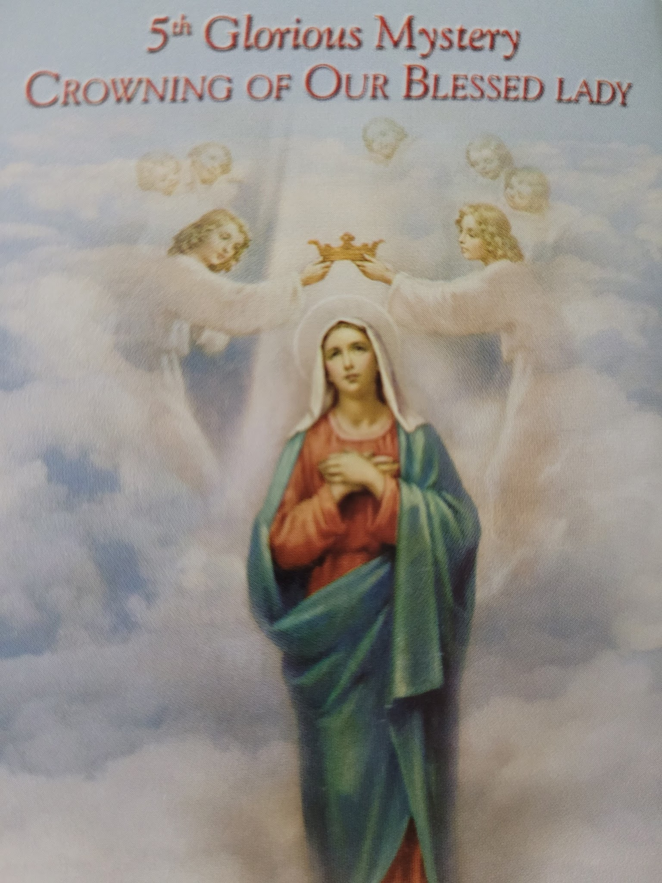
A great sign appeared in heaven; a woman clothed with the sun, and the moon under her feet, and on her head, a crown of twelve stars.
(Rev. 12:1)
Our Father….
Hail Mary…. X10
Glory Be….
Oh, my Jesus forgive us our sins, save us from the fires of hell. Lead all souls to heaven, especially those who are most in need of your mercy. Amen

Slide 28
Hail Holy Queen:
Hail Holy Queen, Mother of Mercy! Our life, our sweetness and our hope! To thee do we cry, poor banished children of Eve, to thee do we send up our sighs, mourning and weeping in this valley of tears. Turn then, most gracious advocate, thy eyes of mercy towards us; and after this, our exile, show unto us the blessed fruit of thy womb, Jesus. O clement, O loving, O sweet Virgin Mary. Pray for us O Holy Mother of God, That we may be made worthy of the promises of Christ.

Slide 29
Lord have mercy
- Lord have mercy
Christ have mercy
- Christ have mercy
Lord have mercy
- Lord have mercy
Christ hear us.
- Christ graciously hear us.
God the Father of heaven
- Have mercy on us
God the Son, Redeemer of the world
-Have mercy on us.
God the Holy Spirit
- Have mercy on us.
Holy Trinity, one God
- Have mercy on us.
Holy Mary
- Pray for us
Mother of God
-Pray for us
Saint Joseph
- Pray for us
Saint Anne
- Pray for us
Saint Francis of Assisi
- Pray for us
Saint Claire of Assisi
- Pray for us.
Saint Agnes of Prague
- Pray for us
Saint Eustochia Calafato
- Pray for us
Saint Veronica Guilani
- Pray for us
Saint Collette of Corbie
- Pray for us

Slide 30
Grant, we beseech Thee, O Lord God, unto us thy servants, that we may rejoice in continual health of mind and body, and by the glorious intercession of the Blessed Mary, ever Virgin, may be delivered from present sadness, and enter into the joy of thine eternal gladness. Through Christ our Lord. Amen

Slide 31
Novena & Rosary to
Our Lady of The Angels
July 24 - August 1
2026
Special Intention: peace in the world
Vision of St. Francis of Assisi
by Vincente Carducho – 1631

Slide 32
THURSDAY JULY 30, 2026

Slide 33
Novena Prayer to Our Lady of The Angels
O Virgin of the Angels,
who has for centuries established your throne of mercy at the Portiuncula,
hear the prayer of your children, who trust in you.
From this truly holy place and the habitation of the Lord,
so dear to the heart of Saint Francis, you have always invited all men to love.
Your tender eyes assure us of a never-failing motherly help
and a promise of divine help to all those who humbly have recourse to your throne,
or who from afar, turn to you to ask for help.
You are, indeed, our sweet Queen and our only hope.
O Lady of the Angels,
obtain for us, through the intercession of blessed Francis,
pardon for our sins,
help us to keep away from sin and indifference,
so that we shall be worthy of calling you our Mother for evermore.
Bless our homes, our toil and our rest,
by giving us that same serenity we experience within the walls of the Portiuncula,
where hate, guilt and tears turn into a song of joy
like that once was sung by the Angels and the seraphic Francis.
Help those who are in need and hungry,
those who are in danger of body and soul,
those who are sad and downhearted,
those who are sick and dying.
Bless us, your most beloved children,
and we pray you, bless also with the same motherly gesture,
all those who are innocent, together with those who are guilty;
those who are faithful, together with those who have gone astray;
those who believe, together with those who are in doubt.
Bless all humanity,
so that all men acknowledging that they are God’s children,
would find through love, real Peace and real Good.
Amen

Slide 34
Ave Maria by Friar Alessandro
Ave Maria
Gratia plena
Maria, gratia plena
Maria, gratia plena
Ave, ave dominus
Dominus tecum
Benedicta tu in muli eribus
Et benedictus
Et benedictus fructus ventris
Ventris tuae, Jesus
Ave Maria
Ave Maria
Mater Dei
Ora pro nobis peccatoribus
Ora pro nobis
Ora, ora pro nobis peccatoribus
Nunc et in hora mortis
Et in hora mortis nostrae
Et in hora mortis nostrae
Et in hora mortis nostrae
Ave Maria
Hail Mary, full of grace,
the Lord is with you;
blessed are you among women,
And blessed is the fruit of your womb, Jesus
Holy Mary, Mother of God
Pray for us sinners now
and at the hour of our death.
Hail Mary, full of grace
Hail Mary, full of grace
Hail the Lord is with you
Blessed are you among women
And blessed is the fruit of your womb, Jesus
Hail Mary, Mother of God
Pray for us sinners, Pray for us
Pray for us sinners
Now and at the hour of death
At the hour of death, our death
At the hour of our death.
Hail Mary!

Slide 35
Luminous Mysteries
In the name of the Father and the son and of the Holy Spirit.
Apostles Creed:
I believe in God, the Father Almighty, creator of heaven and earth and in Jesus Christ his only begotten Son, our Lord, who was conceived by the Holy Spirit, born of the Virgin Mary, suffered under Pontius Pilate, was crucified died and was buried. He descended into hell, on the third day he rose again from the dead, he ascended into heaven, and is seated at the right hand of God, the Father Almighty, from there he will come to judge the living and the dead.
- I believe in the Holy Spirit, the Holy Catholic Church, the communion of saints, the forgiveness of sins, the resurrection of the body and life everlasting. Amen.

Slide 36
Our Father:
Our Father, who art in heaven, hallowed be thy name. Thy kingdom come. Thy will be done on earth as it is in heaven.
- Give us this day our daily bread and forgive us our trespasses as we forgive those who trespass against us. And lead us not into temptation but deliver us from evil. Amen.
For an increase in Faith, Hope and Charity, let us pray:
Hail Mary X3:
Hail Mary, full of grace the Lord is with thee. Blessed art thou amongst women and blessed is the fruit of thy womb, Jesus.
- Holy Mary, Mother of God, pray for us sinners, now And at the hour of our death. Amen
Glory Be:
Glory be to the Father and to the Son and to the Holy Spirit. As it was in the beginning, is now and ever shall be, world without end. Amen

Slide 37
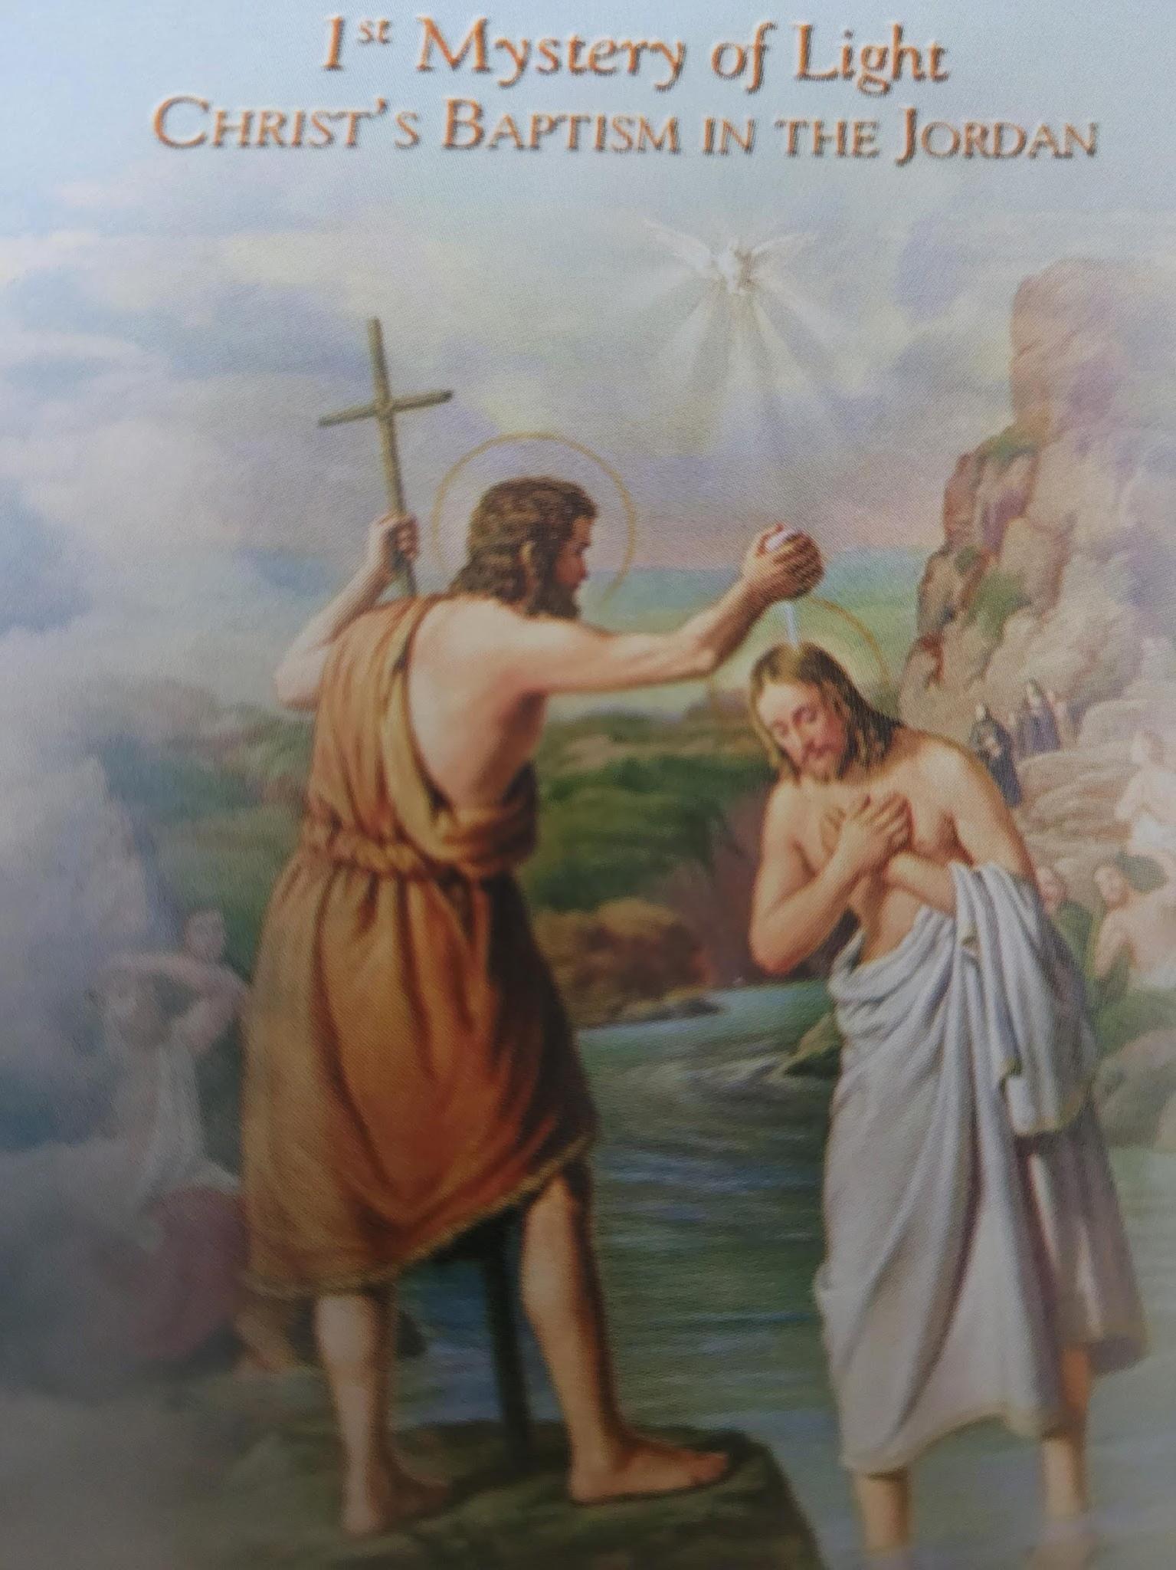
L
In those days Jesus came from Nazareth in Galilee and was baptised by John in the Jordan. Immediately coming up out of the water, He saw the heavens opening, and the Spirit, like a dove descending upon him; and a voice came out of the heavens: You are my beloved son, in you I am well pleased.
(Mark 1: 9-10)
Our Father…
Hail Mary…. X10
Glory Be.
Oh, my Jesus forgive us our sins, save us from the fires of hell. Lead all souls to heaven, especially those who are most in need of your mercy. Amen

Slide 38
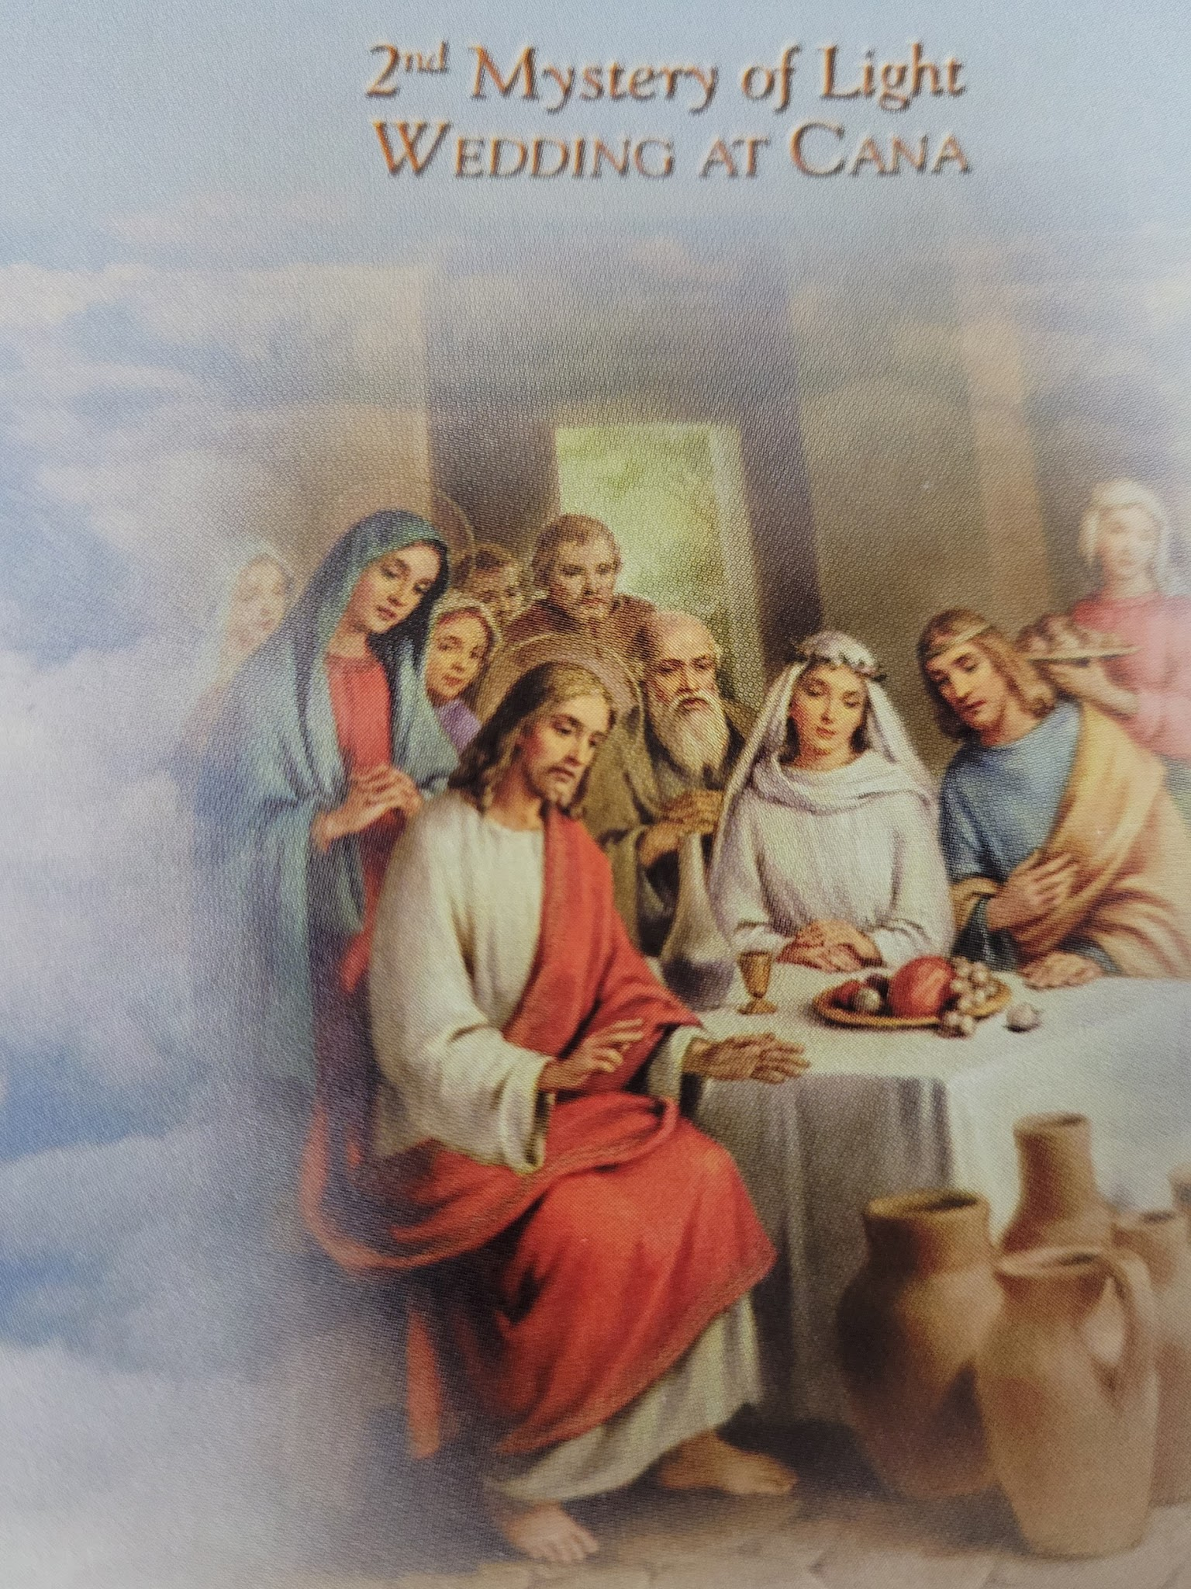
On the third day there was a wedding in Cana of Galilee, and the mother of Jesus was there; and both Jesus and his disciples were invited to the wedding. When the wine ran out, the mother of Jesus said to him, “They have no wine” And Jesus said to her, “Woman, what does that have to do with us? My hour has not yet come.” His mother said to the servants, “Whatever he says to you, do it” …..and manifested his glory and His disciples believed in him.
(John 2: 1-5)
Our Father….
Hail Mary…. X10
Glory Be….
Oh, my Jesus forgive us our sins, save us from the fires of hell. Lead all souls to heaven, especially those who are most in need of your mercy. Amen

Slide 39
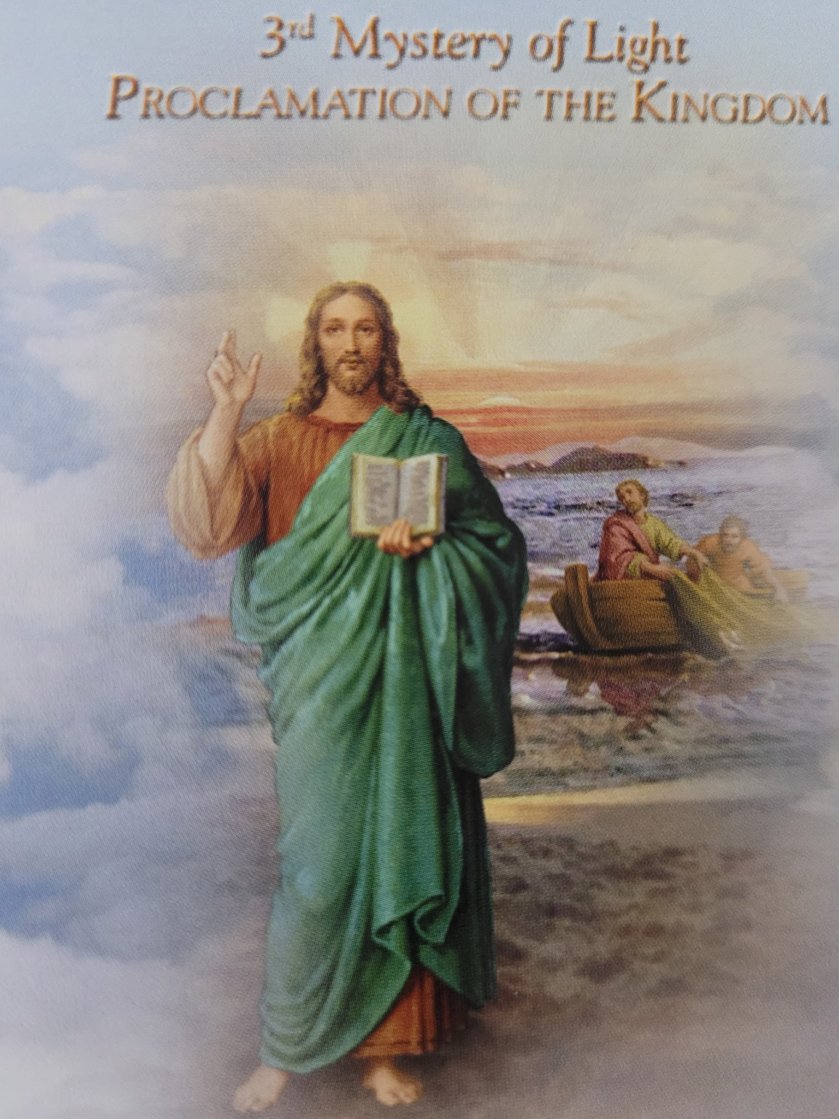
Jesus J
Jesus was going throughout all Galilee, teaching in their synagogues and proclaiming the gospel of the kingdom ,and healing every kind of disease and every kind of sickness among the people.
….Large crowds followed Him from Galilee and the Decapolis and Jerusalem and Judea and from beyond the Jordan.
(Matt. 4: 23, 25)
Our Father….
Hail Mary…. X10
Glory Be….
Oh, my Jesus forgive us our sins, save us from the fires of hell. Lead all souls to heaven, especially those who are most in need of your mercy. Amen

Slide 40
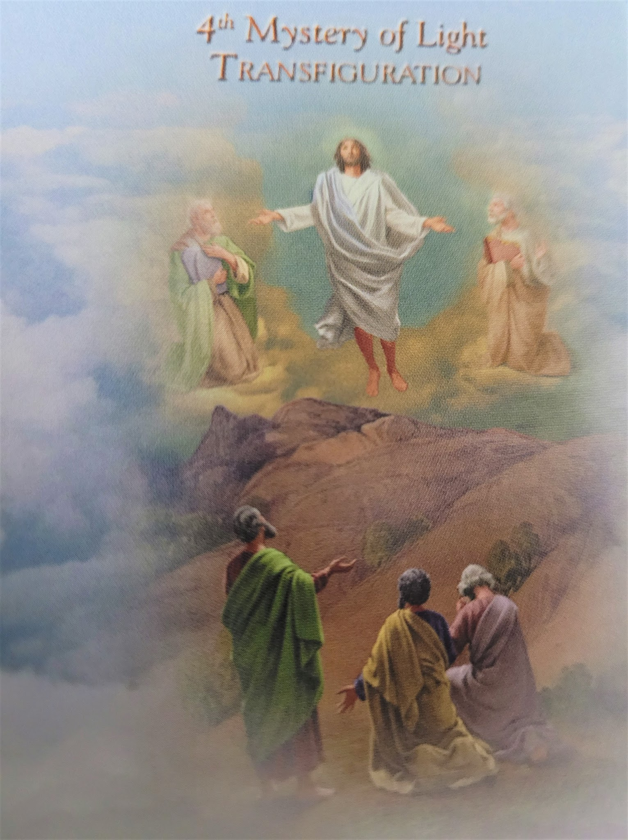
Six days later, Jesus took with him Peter and James and John his brother and led them up a high mountain by themselves. And he was transfigured before them; and His face shone like the sun, and His garments became as white as light. And behold Moses and Elijah appeared to them, talking with Him.
(Matt 17: 1-3)
Our Father….
Hail Mary…. X10
Glory Be….
Oh, my Jesus forgive us our sins, save us from the fires of hell. Lead all souls to heaven, especially those who are most in need of your mercy. Amen

Slide 41
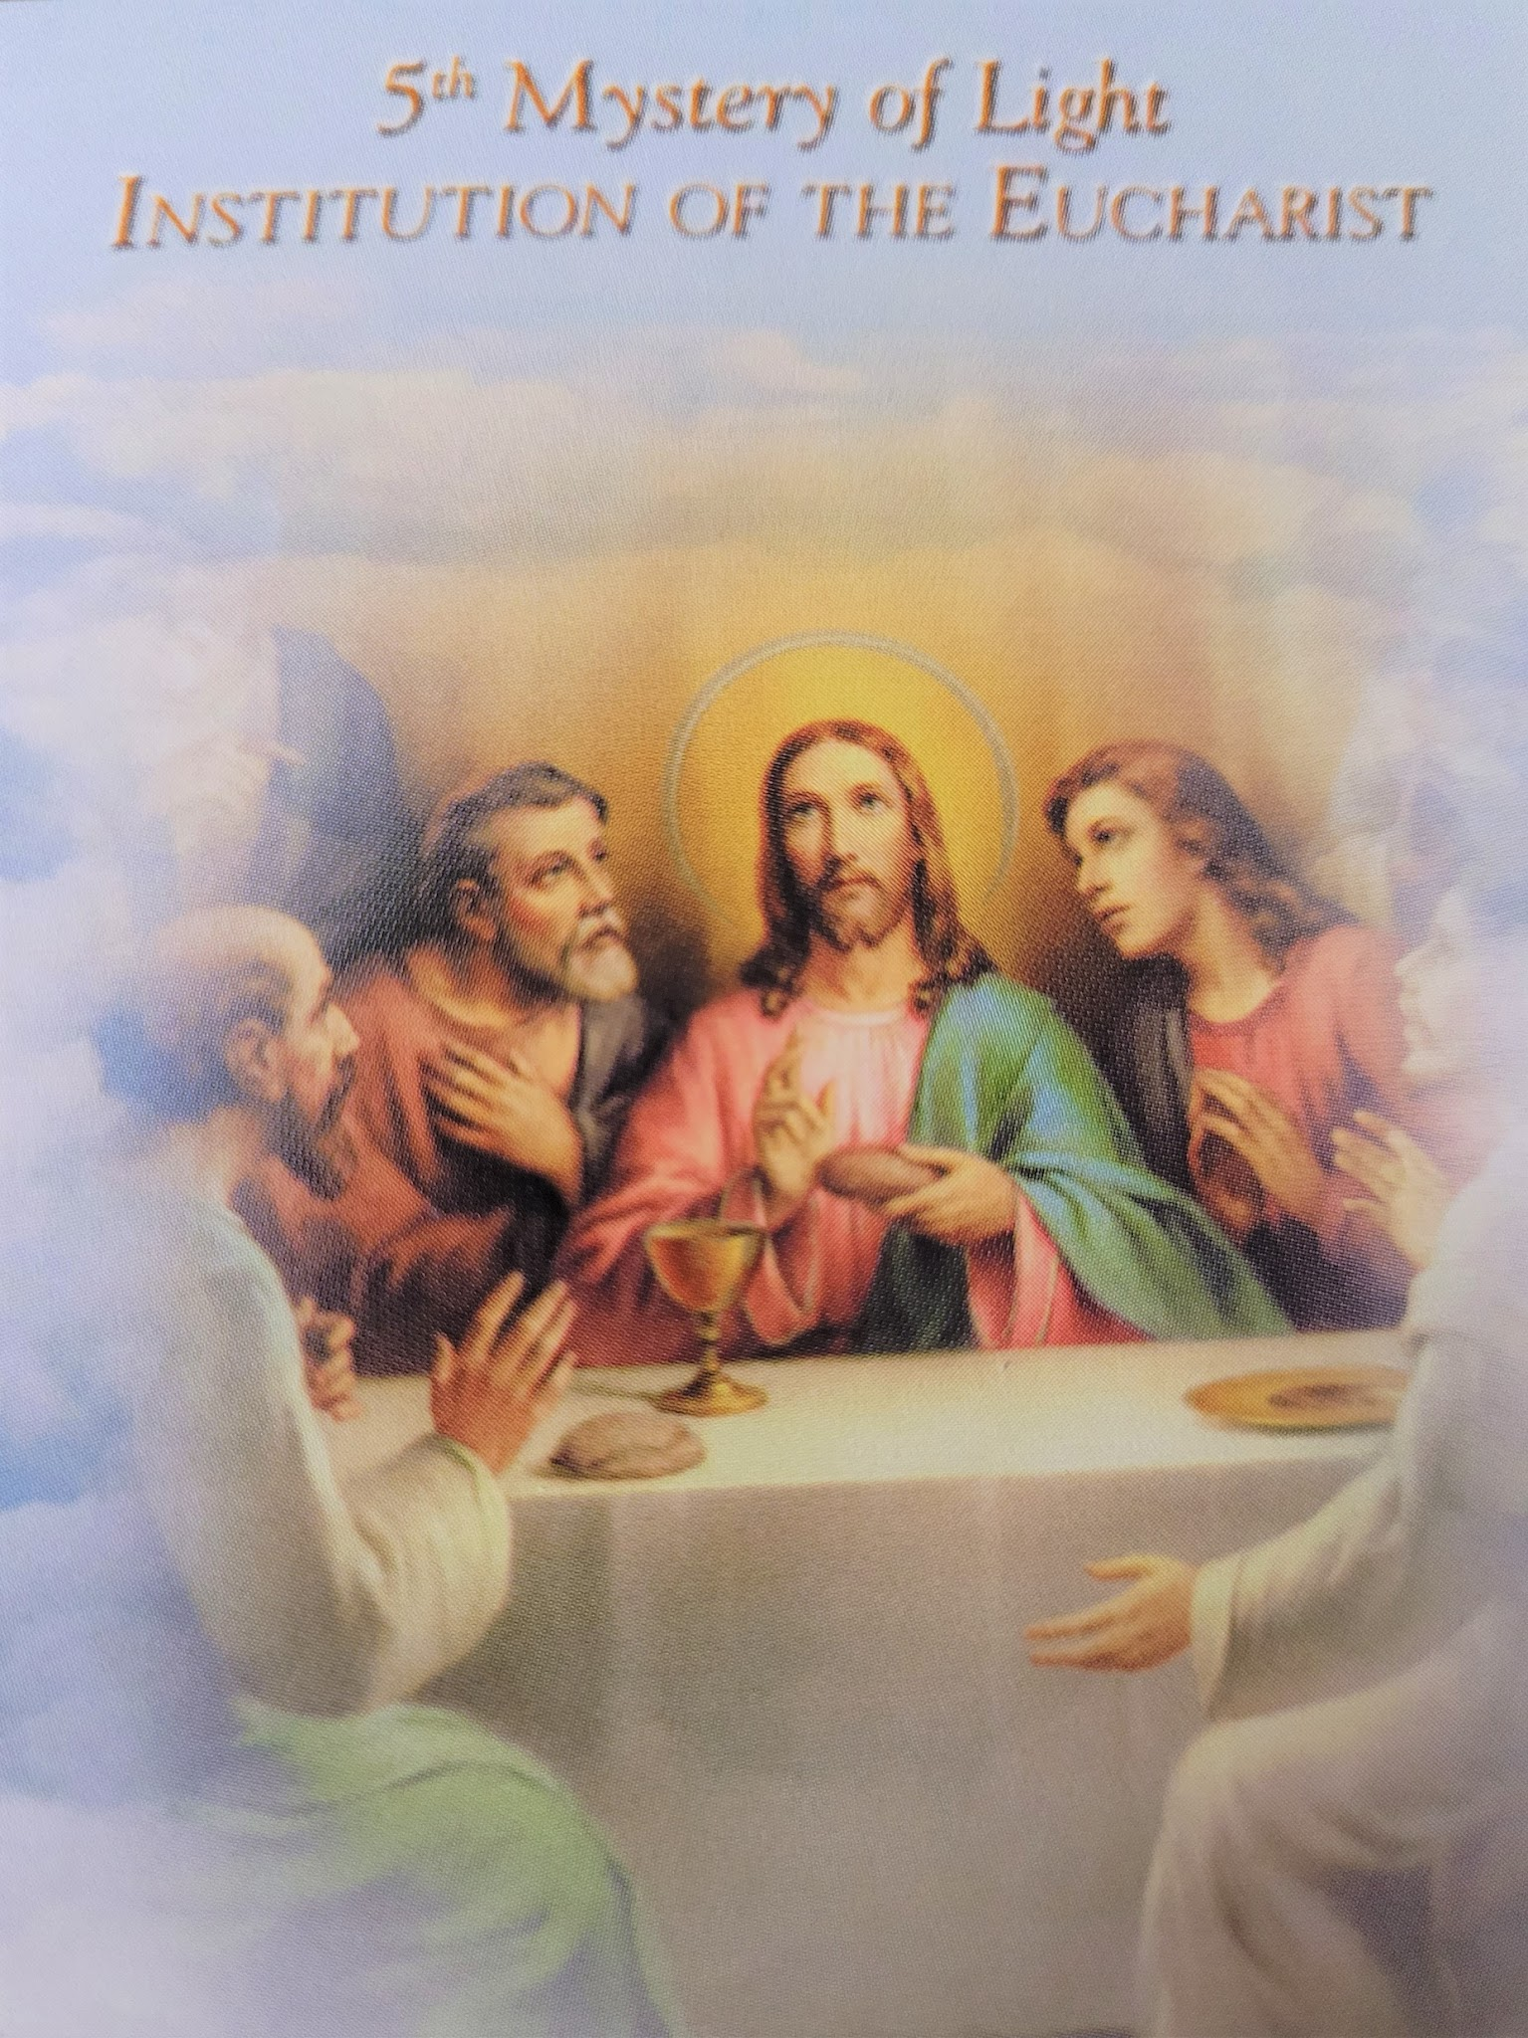
When the hour had come, he reclined at the table, and the apostles with Him. And he said to them, I have earnestly desired to eat this Passover with you before I suffer.; for I say to you, I shall never again eat it until it is fulfilled in the kingdom of God.
(Luke 22: 14-16)
Our Father….
Hail Mary…. X10
Glory Be….
Oh, my Jesus forgive us our sins, save us from the fires of hell. Lead all souls to heaven, especially those who are most in need of your mercy. Amen

Slide 42
Hail Holy Queen:
Hail Holy Queen, Mother of Mercy! Our life, our sweetness and our hope! To thee do we cry, poor banished children of Eve, to thee do we send up our sighs, mourning and weeping in this valley of tears. Turn then, most gracious advocate, thy eyes of mercy towards us; and after this, our exile, show unto us the blessed fruit of thy womb, Jesus. O clement, O loving, O sweet Virgin Mary. Pray for us O Holy Mother of God, That we may be made worthy of the promises of Christ.

Slide 43
Lord have mercy
- Lord have mercy
Christ have mercy
- Christ have mercy
Lord have mercy
- Lord have mercy
Christ hear us.
- Christ graciously hear us.
God the Father of heaven
- Have mercy on us
God the Son, Redeemer of the world
-Have mercy on us.
God the Holy Spirit
- Have mercy on us.
Holy Trinity, one God
- Have mercy on us.
Holy Mary
- Pray for us
Mother of God
-Pray for us
Saint Joseph
- Pray for us
Saint Anne
- Pray for us
Saint Francis
- Pray for us
Saint Claire
- Pray for us.
Saint Anthony of Padua
- Pray for us
Saint Bonaventure
- Pray for us
Saint Lawrence of Brindisi
- Pray for us
Saint Louis of France
- Pray for us
Saint Elizabeth of Hungary
- Pray for us
Saint Pio of Pietrelcina
- Pray for us
Saint Jean Marie Vianney
- Pray for us
Saint Maximillian Kolbe
- Pray for us

Slide 44
Grant, we beseech Thee, O Lord God, unto us thy servants, that we may rejoice in continual health of mind and body, and by the glorious intercession of the Blessed Mary, ever Virgin, may be delivered from present sadness, and enter into the joy of thine eternal gladness. Through Christ our Lord. Amen

Slide 45
Novena & Rosary to
Our Lady of The Angels
July 24 - August 1
2026
Special Intention: peace in the world
Vision of St. Francis of Assisi
by Vincente Carducho – 1631

Slide 46
SATURDAY July 25, 2026
MONday July 27, 2026
sATURDAY AUG 1, 2026

Slide 47
Novena Prayer to Our Lady of The Angels
O Virgin of the Angels,
who has for centuries established your throne of mercy at the Portiuncula,
hear the prayer of your children, who trust in you.
From this truly holy place and the habitation of the Lord,
so dear to the heart of Saint Francis, you have always invited all men to love.
Your tender eyes assure us of a never-failing motherly help
and a promise of divine help to all those who humbly have recourse to your throne,
or who from afar, turn to you to ask for help.
You are, indeed, our sweet Queen and our only hope.
O Lady of the Angels,
obtain for us, through the intercession of blessed Francis,
pardon for our sins,
help us to keep away from sin and indifference,
so that we shall be worthy of calling you our Mother for evermore.
Bless our homes, our toil and our rest,
by giving us that same serenity we experience within the walls of the Portiuncula,
where hate, guilt and tears turn into a song of joy
like that once was sung by the Angels and the seraphic Francis.
Help those who are in need and hungry,
those who are in danger of body and soul,
those who are sad and downhearted,
those who are sick and dying.
Bless us, your most beloved children,
and we pray you, bless also with the same motherly gesture,
all those who are innocent, together with those who are guilty;
those who are faithful, together with those who have gone astray;
those who believe, together with those who are in doubt.
Bless all humanity,
so that all men acknowledging that they are God’s children,
would find through love, real Peace and real Good.
Amen

Slide 48
Hail Queen of Heaven, The Ocean Star
By Chris Brunelle
Hail, Queen of Heaven, the ocean Star,
Guide of the wanderer here below,
Thrown on life's surge, we claim thy care:
Save us from peril and from woe.
Mother of Christ, star of the sea,
Pray for the wanderer, pray for me.
O gentle, chaste and spotless Maid,
We sinners make our prayers through thee.
Remind thy Son that we are stayed
The price of our iniquity.
Virgin most pure, star of the sea,
Pray for the sinner, oh pray for me, Pray for the sinner, oh pray for me.
And while to Him who reigns above,
In Godhead One, in Persons Three,
The source of life, of grace and love,
Homage we pay on bended knee.
Through Thou, bright Queen, star of the sea,
Pray for thy children, pray for me.
Pray for thy children, pray for me

Slide 49
Joyful Mysteries
In the name of the Father and the son and of the Holy Spirit.
Apostles Creed:
I believe in God, the Father Almighty, creator of heaven and earth and in Jesus Christ his only begotten Son, our Lord, who was conceived by the Holy Spirit, born of the Virgin Mary, suffered under Pontius Pilate, was crucified died and was buried. He descended into hell, on the third day he rose again from the dead, he ascended into heaven, and is seated at the right hand of God, the Father Almighty, from there he will come to judge the living and the dead.
- I believe in the Holy Spirit, the Holy Catholic Church, the communion of saints, the forgiveness of sins, the resurrection of the body and life everlasting. Amen.

Slide 50
Our Father:
Our Father, who art in heaven, hallowed be thy name. Thy kingdom come. Thy will be done on earth as it is in heaven.
- Give us this day our daily bread and forgive us our trespasses as we forgive those who trespass against us. And lead us not into temptation but deliver us from evil. Amen.
For an increase in Faith, Hope and Charity, let us pray:
Hail Mary X3:
Hail Mary, full of grace the Lord is with thee. Blessed art thou amongst women and blessed is the fruit of thy womb, Jesus.
- Holy Mary, Mother of God, pray for us sinners, now And at the hour of our death. Amen
Glory Be:
Glory be to the Father and to the Son and to the Holy Spirit. As it was in the beginning, is now and ever shall be, world without end. Amen

Slide 51
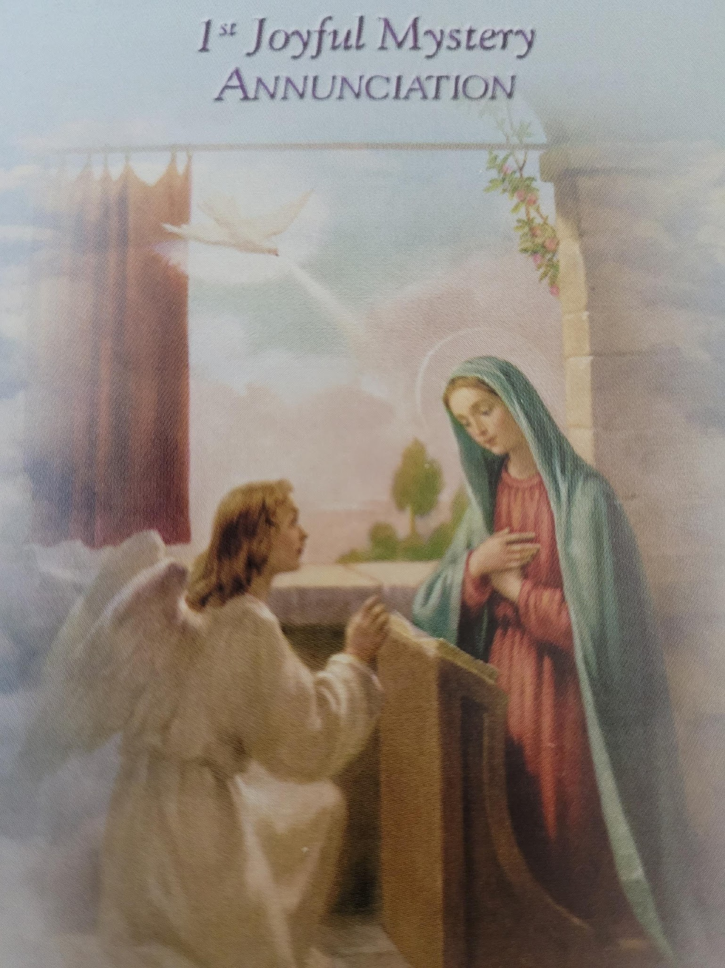
And coming in he said to her, “Greetings, favoured one! The Lord is with you.”
“And behold, you will conceive in your womb and bear a son, and you shall name him Jesus.”
(Luke 1: 28-31)
Our Father…
Hail Mary…. X10
Glory Be.
Oh, my Jesus forgive us our sins, save us from the fires of hell. Lead all souls to heaven, especially those who are most in need of your mercy. Amen

Slide 52
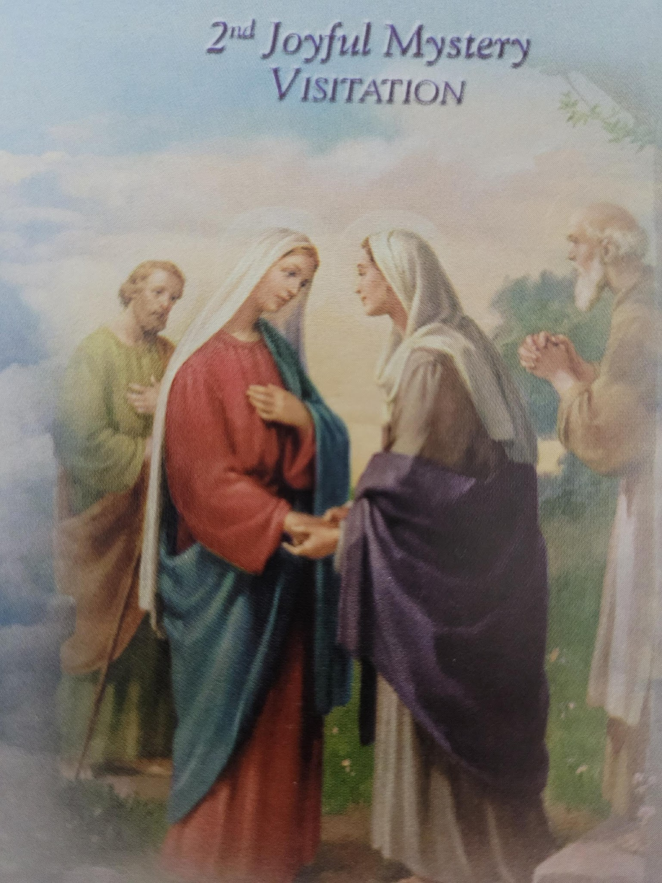
When Elizabeth heard Mary’s greeting, the baby leaped in her womb; and Elizabeth was filled with the Holy Spirit. And she cried out with a loud voice and said, “Blessed are you among women, and blessed is the fruit of your womb!”
(Luke 1: 41-42)
Our Father….
Hail Mary…. X10
Glory Be….
Oh, my Jesus forgive us our sins, save us from the fires of hell. Lead all souls to heaven, especially those who are most in need of your mercy. Amen

Slide 53
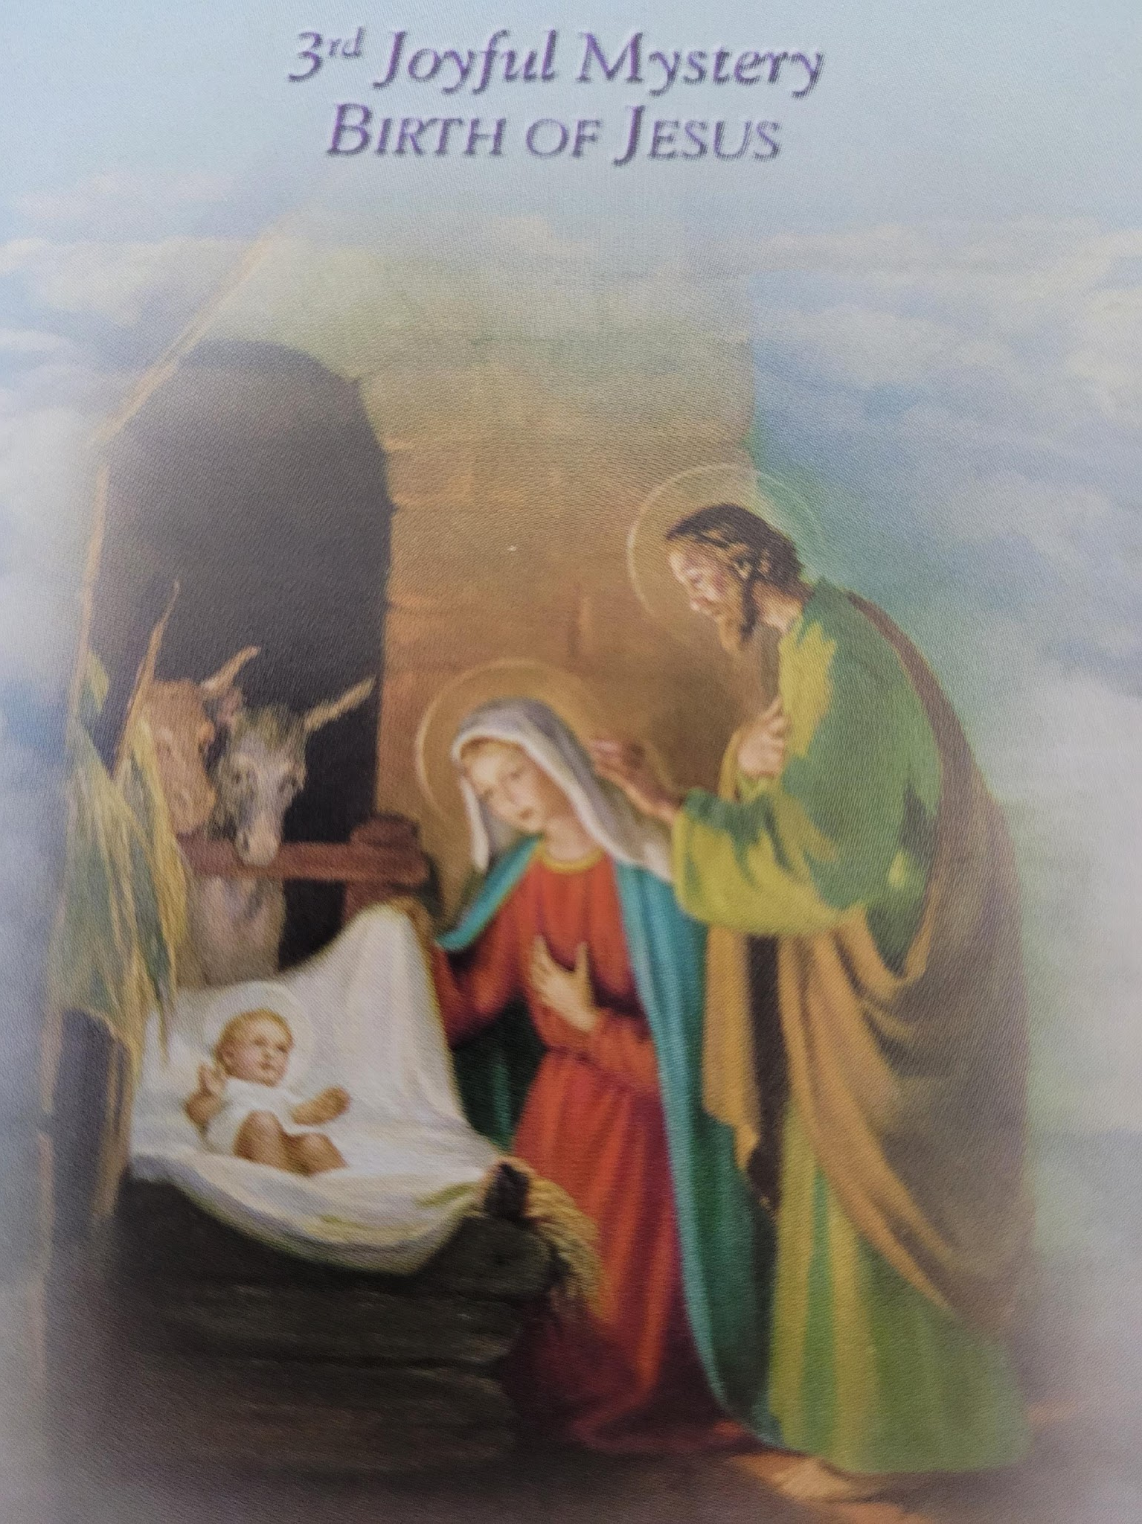
And she gave birth to her firstborn son; and she wrapped Him in cloths, and laid him in a manger, because there was no room for them in the inn.
(Luke 2: 7)
Our Father….
Hail Mary…. X10
Glory Be….
Oh, my Jesus forgive us our sins, save us from the fires of hell. Lead all souls to heaven, especially those who are most in need of your mercy. Amen

Slide 54
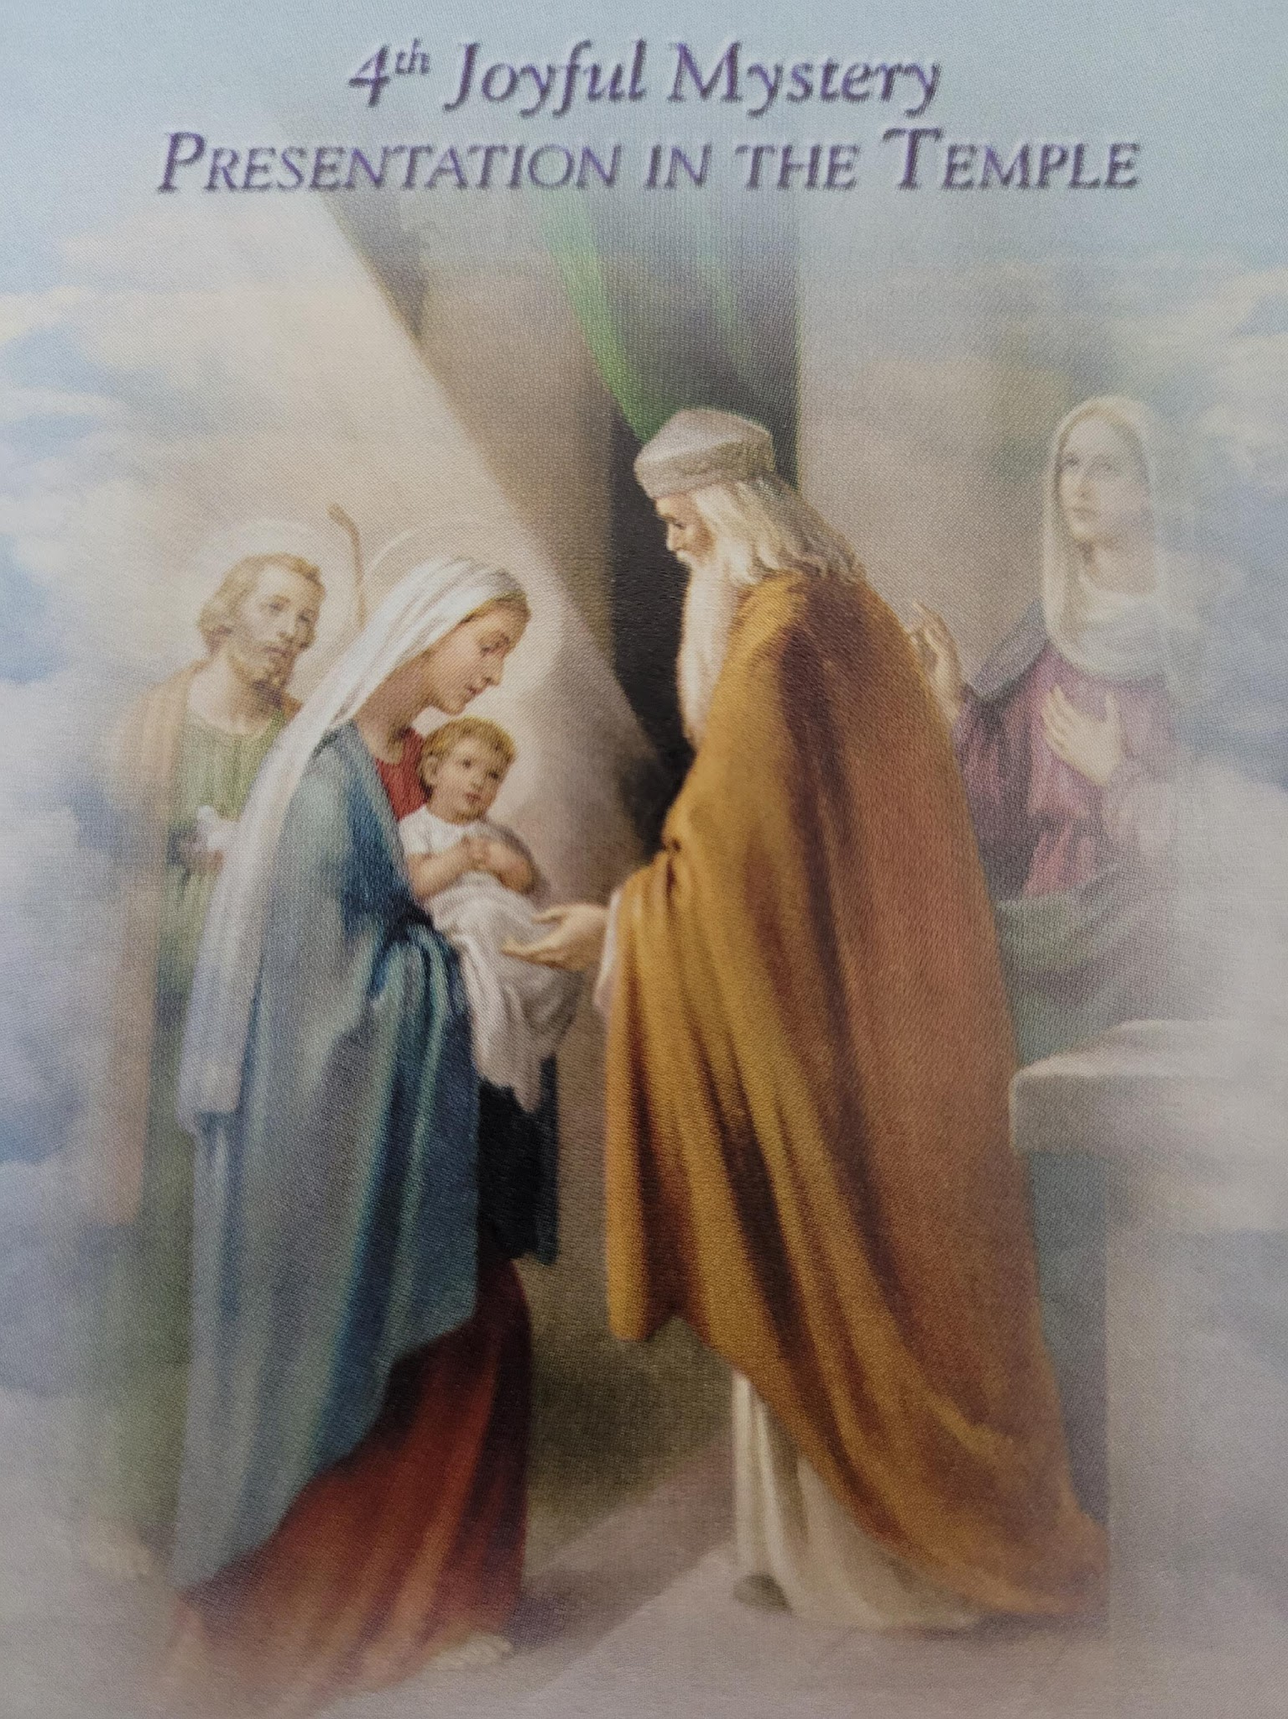
And when the days for their purification according to the law of Moses were completed, they brought Him up to Jerusalem to present Him to the Lord as it is written in the Law of the Lord; “Every firstborn male that opens the womb shall be called holy to the Lord.”
(Luke 2: 22-23)
Our Father….
Hail Mary…. X10
Glory Be….
Oh, my Jesus forgive us our sins, save us from the fires of hell. Lead all souls to heaven, especially those who are most in need of your mercy. Amen

Slide 55
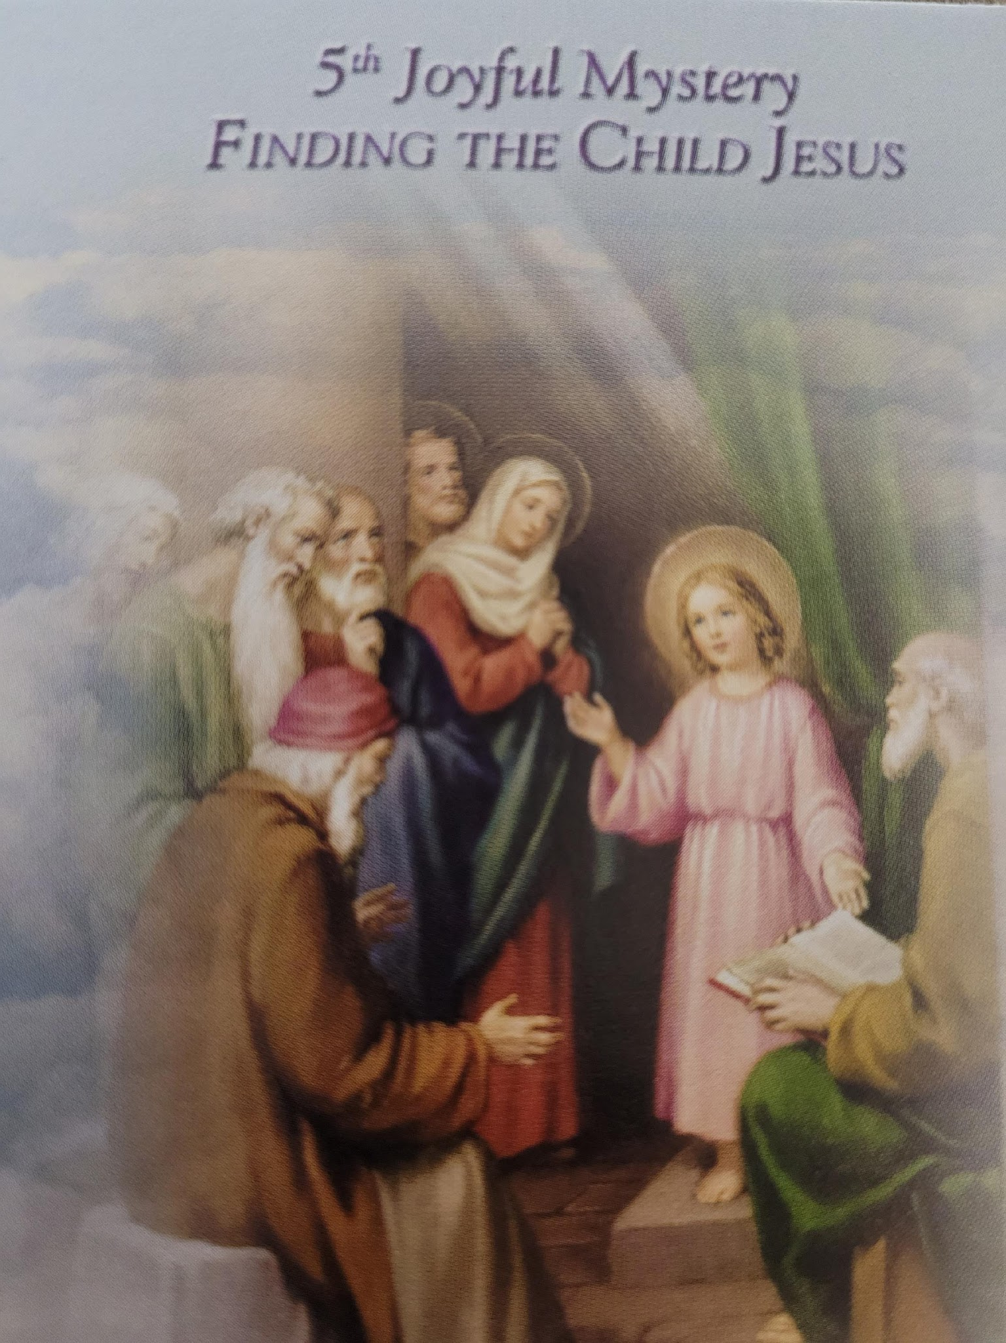
And he said to them, “Why is it that you were looking for Me? Did you not know that I had to be in my Father’s house?”
And he went down with them and came to Nazareth, and he continued in subjection to them; and His mother treasured all these things in her heart.
(Luke 2: 49-51)
Our Father….
Hail Mary…. X10
Glory Be….
Oh, my Jesus forgive us our sins, save us from the fires of hell. Lead all souls to heaven, especially those who are most in need of your mercy. Amen

Slide 56
Hail Holy Queen:
Hail Holy Queen, Mother of Mercy! Our life, our sweetness and our hope! To thee do we cry, poor banished children of Eve, to thee do we send up our sighs, mourning and weeping in this valley of tears. Turn then, most gracious advocate, thy eyes of mercy towards us; and after this, our exile, show unto us the blessed fruit of thy womb, Jesus. O clement, O loving, O sweet Virgin Mary. Pray for us O Holy Mother of God, That we may be made worthy of the promises of Christ.

Slide 57
Lord have mercy
- Lord have mercy
Christ have mercy
- Christ have mercy
Lord have mercy
- Lord have mercy
Christ hear us.
- Christ graciously hear us.
God the Father of heaven
- Have mercy on us
God the Son, Redeemer of the world
-Have mercy on us.
God the Holy Spirit
- Have mercy on us.
Holy Trinity, one God
- Have mercy on us.
Holy Mary
- Pray for us
Mother of God
-Pray for us
Saint Joseph
- Pray for us
Saint Anne
- Pray for us
Saint Francis
- Pray for us
Saint Claire
- Pray for us.
Saint Ferdinand III of Castille
- Pray for us
Saint Zita of Lucca
- Pray for us
Saint Anna Schaeffer
- Pray for us
Saint Rose of Vitebro
- Pray for us
Saint Thomas Moore
- Pray for us

Slide 58
Grant, we beseech Thee, O Lord God, unto us thy servants, that we may rejoice in continual health of mind and body, and by the glorious intercession of the Blessed Mary, ever Virgin, may be delivered from present sadness, and enter into the joy of thine eternal gladness. Through Christ our Lord. Amen

Slide 59
Feast of
Our Lady of The Angels
Franciscan Crown rosary & vespers
^{august 2, 2026}
special Intention: peace in the world
Vision of St. Francis of Assisi
by Vincente Carducho – 1631

Slide 60
Hail Mary: Gentle Woman by Eternity Music
Hail Mary, full of grace, the Lord is with you.
Blessed are you among women,
And blest is the fruit of your womb, Jesus.
Holy Mary, mother of God,
Pray for us sinners now,
and at the hour of death. Amen
Refrain:
Gentle woman, quiet light;
Morning star, so strong and bright.
Gentle mother, peaceful dove,
Teach us wisdom, teach us love.
You were chosen by the Father;
You were chosen for the Son.
You were chosen from all women,
And for woman, shining one.
Refrain.
Blessed are you, among women.
Blest in turn, all women too.
Blessed they, with peaceful spirits,
Blessed they, with gentle hearts.
Refrain

Slide 61
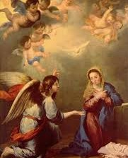
Mary’s 1st Joy - The Annunciation. We pray for the gift of fortitude.
Our Father Hail Mary x10 Glory Be
Prayer: O God, who willed that your Word should take on the reality of human flesh in the womb of the Virgin Mary, grant, we pray, that we, who confess our Redeemer to be God and man, may merit to become partakers in his divine nature. Who lives and reigns with you in the unity of the Holy Spirit, one God, forever and ever. Amen
The Annunciation – Bartholome Esteban Murillo

Slide 62
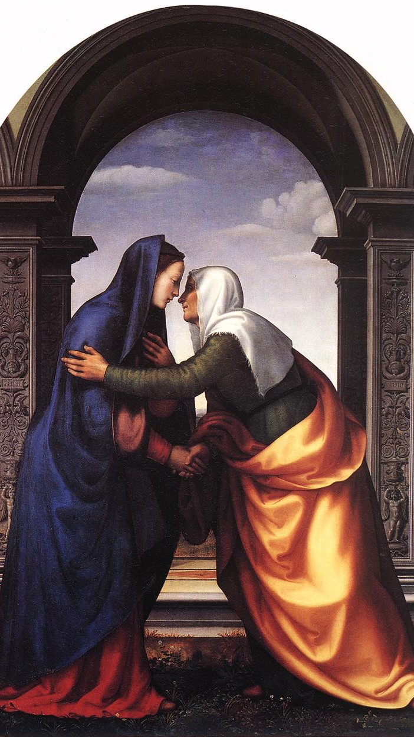
Mary’s 2nd Joy - The Visitation. We pray for the gift of Counsel.
Our Father Hail Mary x10 Glory Be
Prayer: Almighty ever-living God, who, while the Blessed Virgin Mary was carrying your Son in her womb, inspired her to visit Elizabeth, grant us, we pray, that, faithful to the promptings of the Spirit, we may always magnify your greatness with the Virgin Mary. We ask this through our Lord Jesus Christ, your Son, who lives and reigns with you in the unity of the Holy Spirit, one God, for ever and ever. Amen.
The Visitation – Mariotto Albertinelli

Slide 63
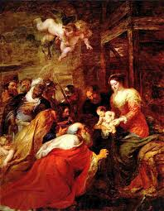
Mary’s 3rd Joy - The Adoration of The Magi. We pray for the gift of The Fear of The Lord
Our Father Hail Mary x10 Glory Be
Prayer: Grant, we pray, almighty God, that, as we are bathed in the new radiance of your incarnate Word, the light of faith, which illumines our minds, may also shine through in our deeds. We ask this through our Lord Jesus Christ, your Son, who lives and reigns with you in the unity of the Holy Spirit, one God, for ever and ever. Amen.
Adoration of The Magi – Peter Paul Rubens

Slide 64
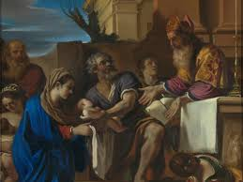
Mary’s 4th Joy - The Presentation of Our Lord. We pray for the gift of Wisdom
Our Father Hail Mary x10 Glory Be
Prayer: Almighty ever-living God, we humbly implore your majesty that, just as your Only Begotten Son was presented on this day in the Temple in the substance of our flesh, so, by your grace, we may be presented to you with minds made pure. We ask this through our Lord Jesus Christ, your Son, who lives and reigns with you in the unity of the Holy Spirit, one God, for ever and ever. Amen
The Presentation of Jesus in the Temple
Giovanni Francesco Barbieri – Il Guercino

Slide 65
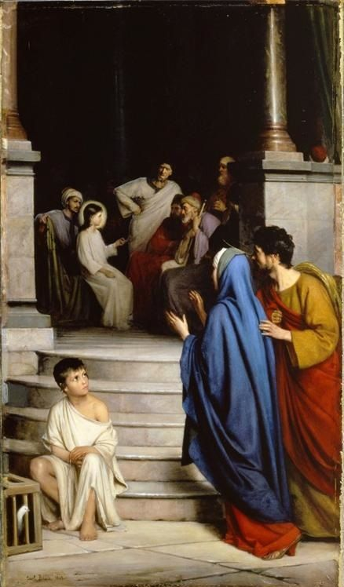
Mary’s 5th Joy - The finding of Jesus in the Temple. We pray for the gift of Understanding
Our Father Hail Mary x10 Glory Be
Prayer: O God, you who were pleased to give us the shining example of the Holy Family, graciously grant that we may imitate them in practicing the virtues of family life and in the bonds of charity, and so, in the joy of your house, delight one day in eternal rewards. We ask this through our Lord Jesus Christ, your Son, who lives and reigns with you in the unity of the Holy Spirit, one God, for ever and ever. Amen.
Finding of Jesus in the Temple – Carl Heinrich Bloch

Slide 66
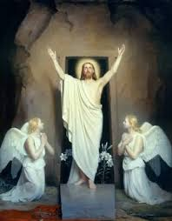
Mary’s 6th Joy - The Resurrection of Our Lord. We pray for the gifts of Piety and Love.
Our Father Hail Mary x10 Glory Be
Prayer: O God, you who on this day, through your Only Begotten Son, have conquered death and unlocked for us the path to eternity, grant, we pray, that we who keep the solemnity of the Lord’s Resurrection may, through the renewal brought by your Spirit, rise up in the light of life. We ask this through our Lord Jesus Christ, your Son, who lives and reigns with you in the unity of the Holy Spirit, one God, for ever and ever. Amen
The Resurrection of Christ – Carl Heinrich Bloch

Slide 67
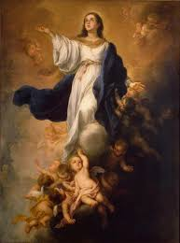
Mary’s 7th Joy - The Assumption of the Blessed Virgin. We pray for the gift of knowledge.
Our Father Hail Mary x10 Glory Be
Prayer 7: O God, who, looking on the lowliness of the Blessed Virgin Mary, raised her to this grace, that your Only Begotten Son was born of her according to the flesh and that she was crowned this day with surpassing glory, grant through her prayers, that, saved by the mystery of your redemption, we may merit to be exalted by you on high. We ask this through our Lord Jesus Christ, your Son, who lives and reigns with you in the unity of the Holy Spirit, one God, for ever and ever. Amen.
The Assumption of the Blessed Virgin Mary –
Bartholome Esteban Murillo

Slide 68
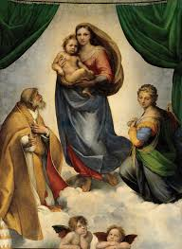
To complete Mary’s joys upon the earth, let us pray: Hail Mary x 2
Sistine Madonna - Raphael

Slide 69
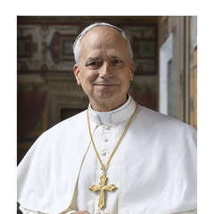
For the intentions of
Holy Father Pope Leo XIV
we pray:
Our Father
Hail Mary
Glory Be

Slide 70
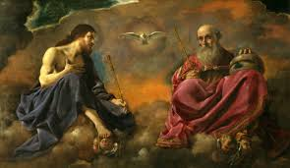
In the name of the Father and of the Son and of the Holy Spirit. Amen
The Trinity – Giovanni Francesco Barbieri – Il Guercino
Make Me A Channel of Your Peace by Friar Alessandro

